Slide 1
Water Quality analysis

Slide 2
Group-3
Name -
Shunottara Alhat
Thanu Bujji
Lily Susanna
Ananya Biswas
Shubham Swarnakar
Veena Tiwari

Slide 3
Feature Description
ph value
Hardness
Solids
Chloramines
Sulfate
Conductivity
Organic_carbon
Trihalomethanes
Turbidity
Potability

Slide 4
Introduction
Data Science helps in gathering and getting useful information to make sound decisions.
Machine Learning helps in applying algorithms to get the predicted result.
Python language helps in applying the tools and techniques.
Aim of the project to predict the potability using classification machine learning model.
Overview of Project (Water Quality)
Access to safe drinking-water is essential to health, a basic human right and a component of effective policy for health protection. This is important as a health and development issue at a national, regional and local level. In some regions, it has been shown that investments in water supply and sanitation can yield a net economic benefit, since the reductions in adverse health effects and health care costs outweigh the costs of undertaking the interventions.

Slide 5
Data Science Lifecycle
Business Understanding
Data Understanding
Data Preparation
Exporatory Data Analysis
Data Modeling
Model Evaluation
Model Deployment

Slide 6
WorkFlow
Importing Libraries
Importing Data
Exploratory Data Analysis and Visualization
Splitting
Model Building
Base Model
Final Model
Pickle
Deployment

Slide 7
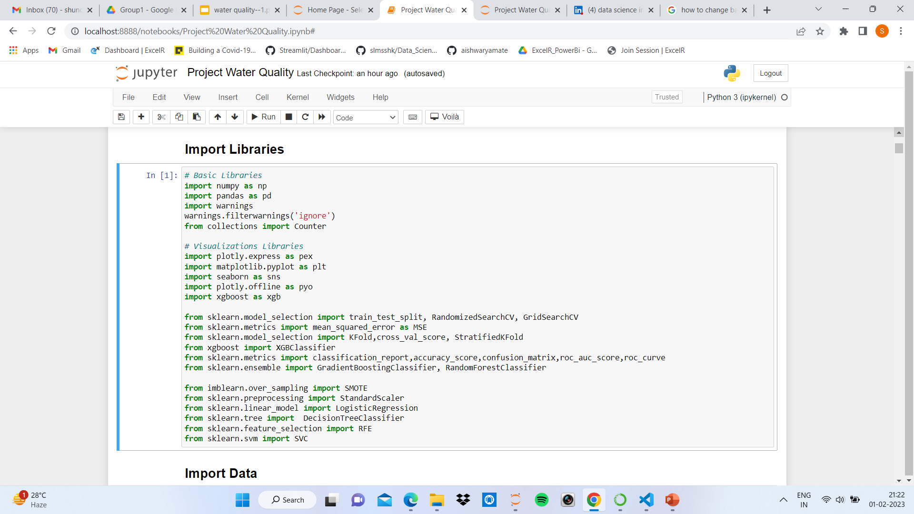
Importing Libraries

Slide 8
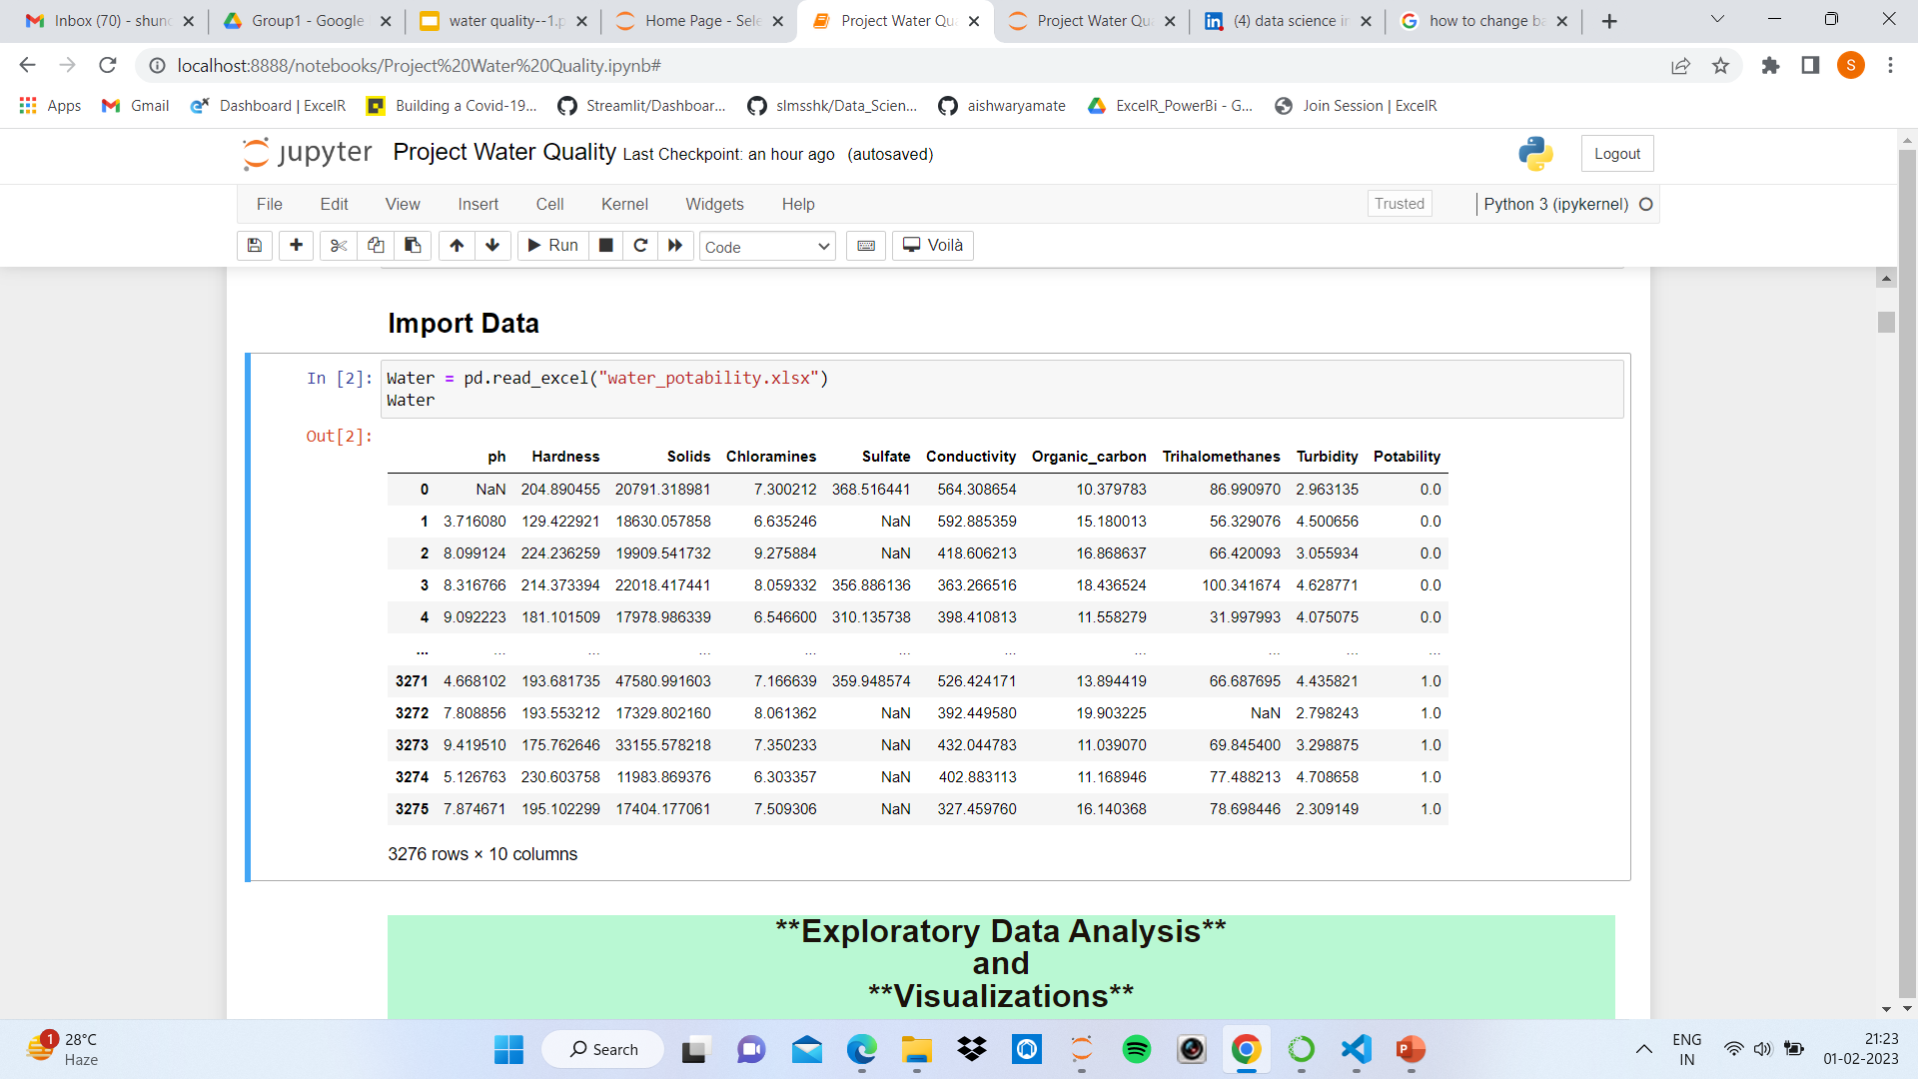
Importing the Dataset

Slide 9
EDA(Exploratory Data Analysis) And Visualization
Water.isnull().sum() : Checks for missing, null values in the dataset.
Water.info() : gives the information about datatype of the columns.
Water.describe() :gives the statistical values of the dataset.
Handling the missing values by filling it with the mean values of the attribute.

Slide 10
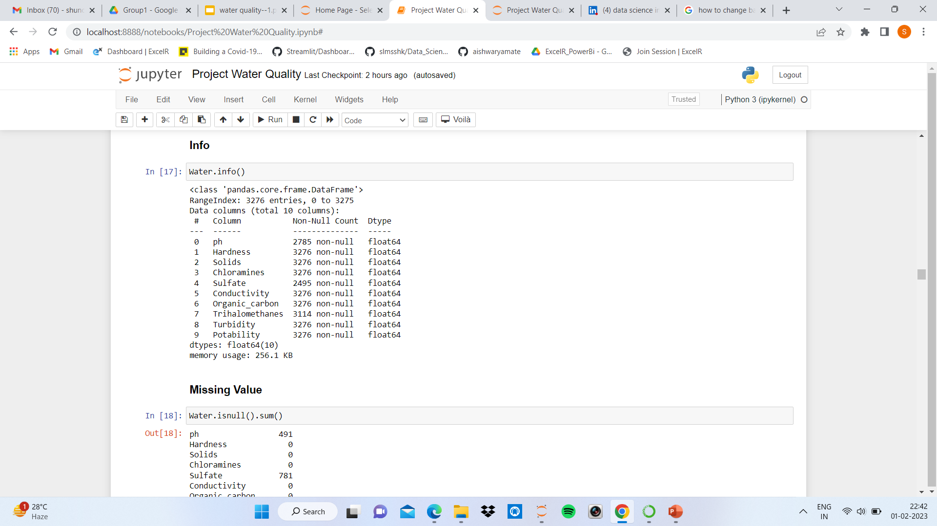
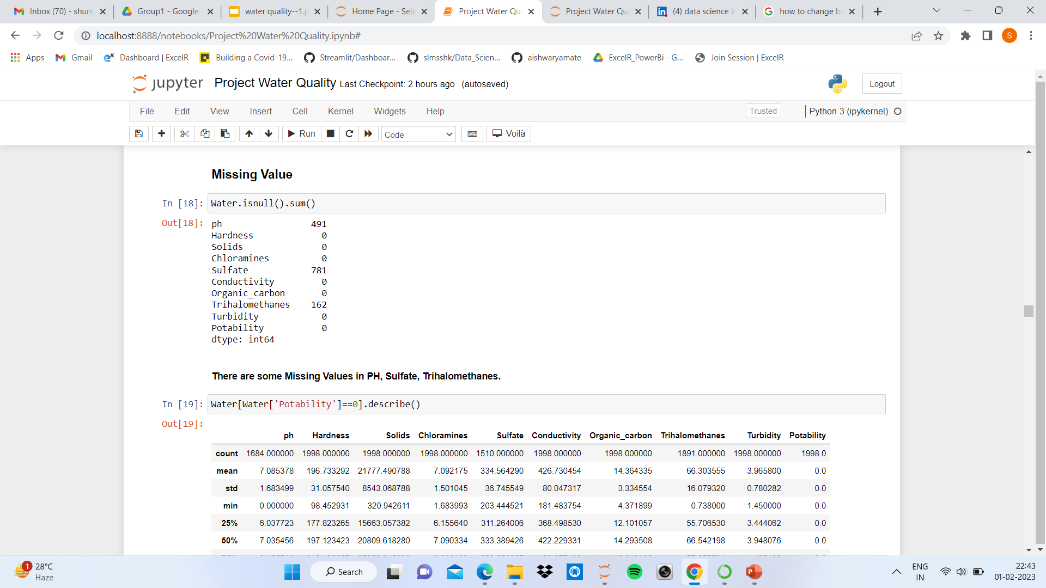

Slide 11
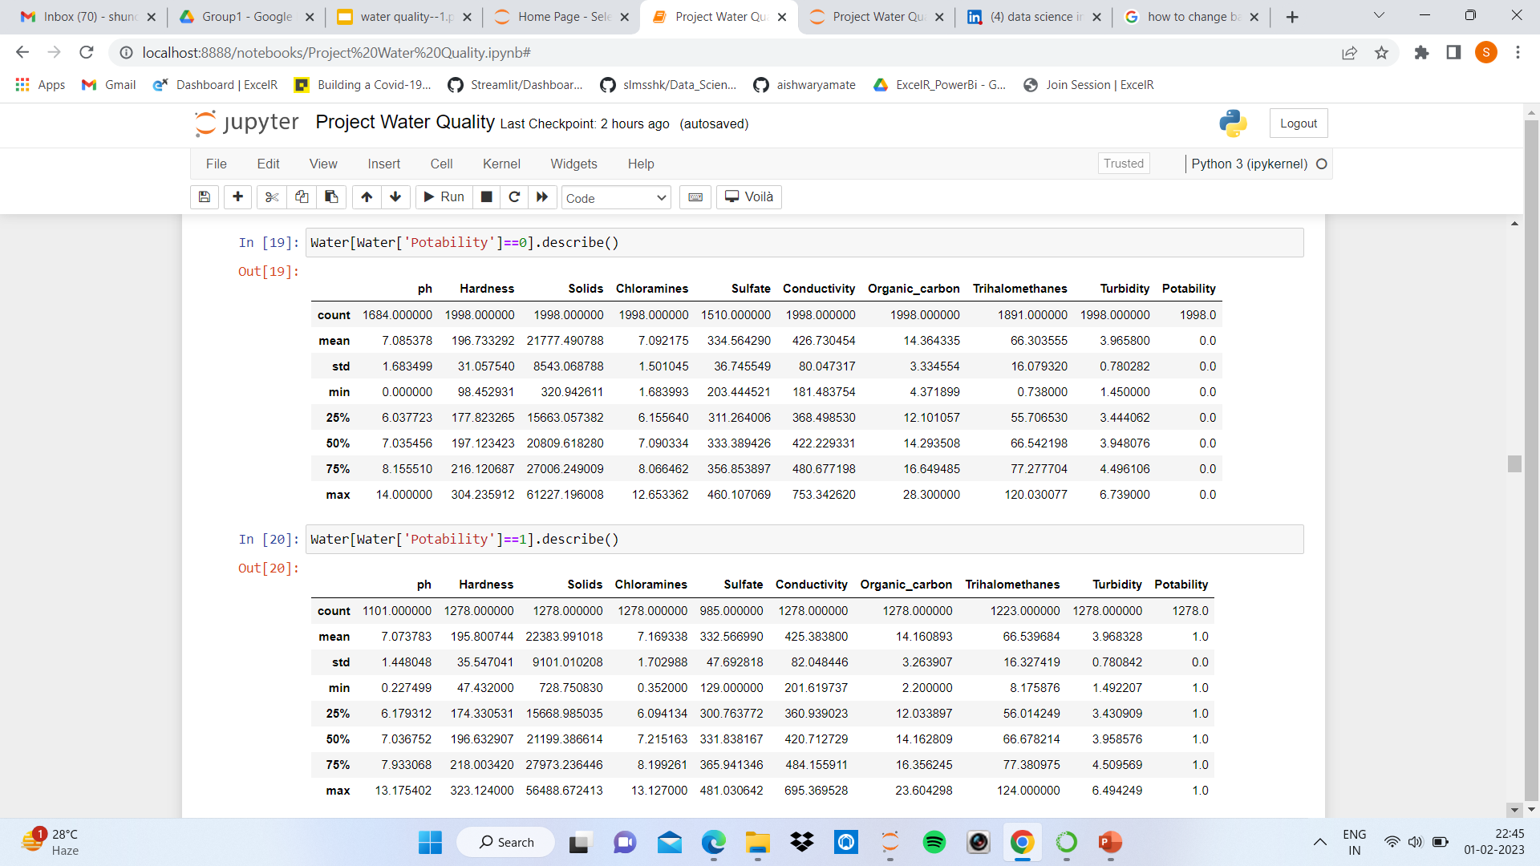

Slide 12
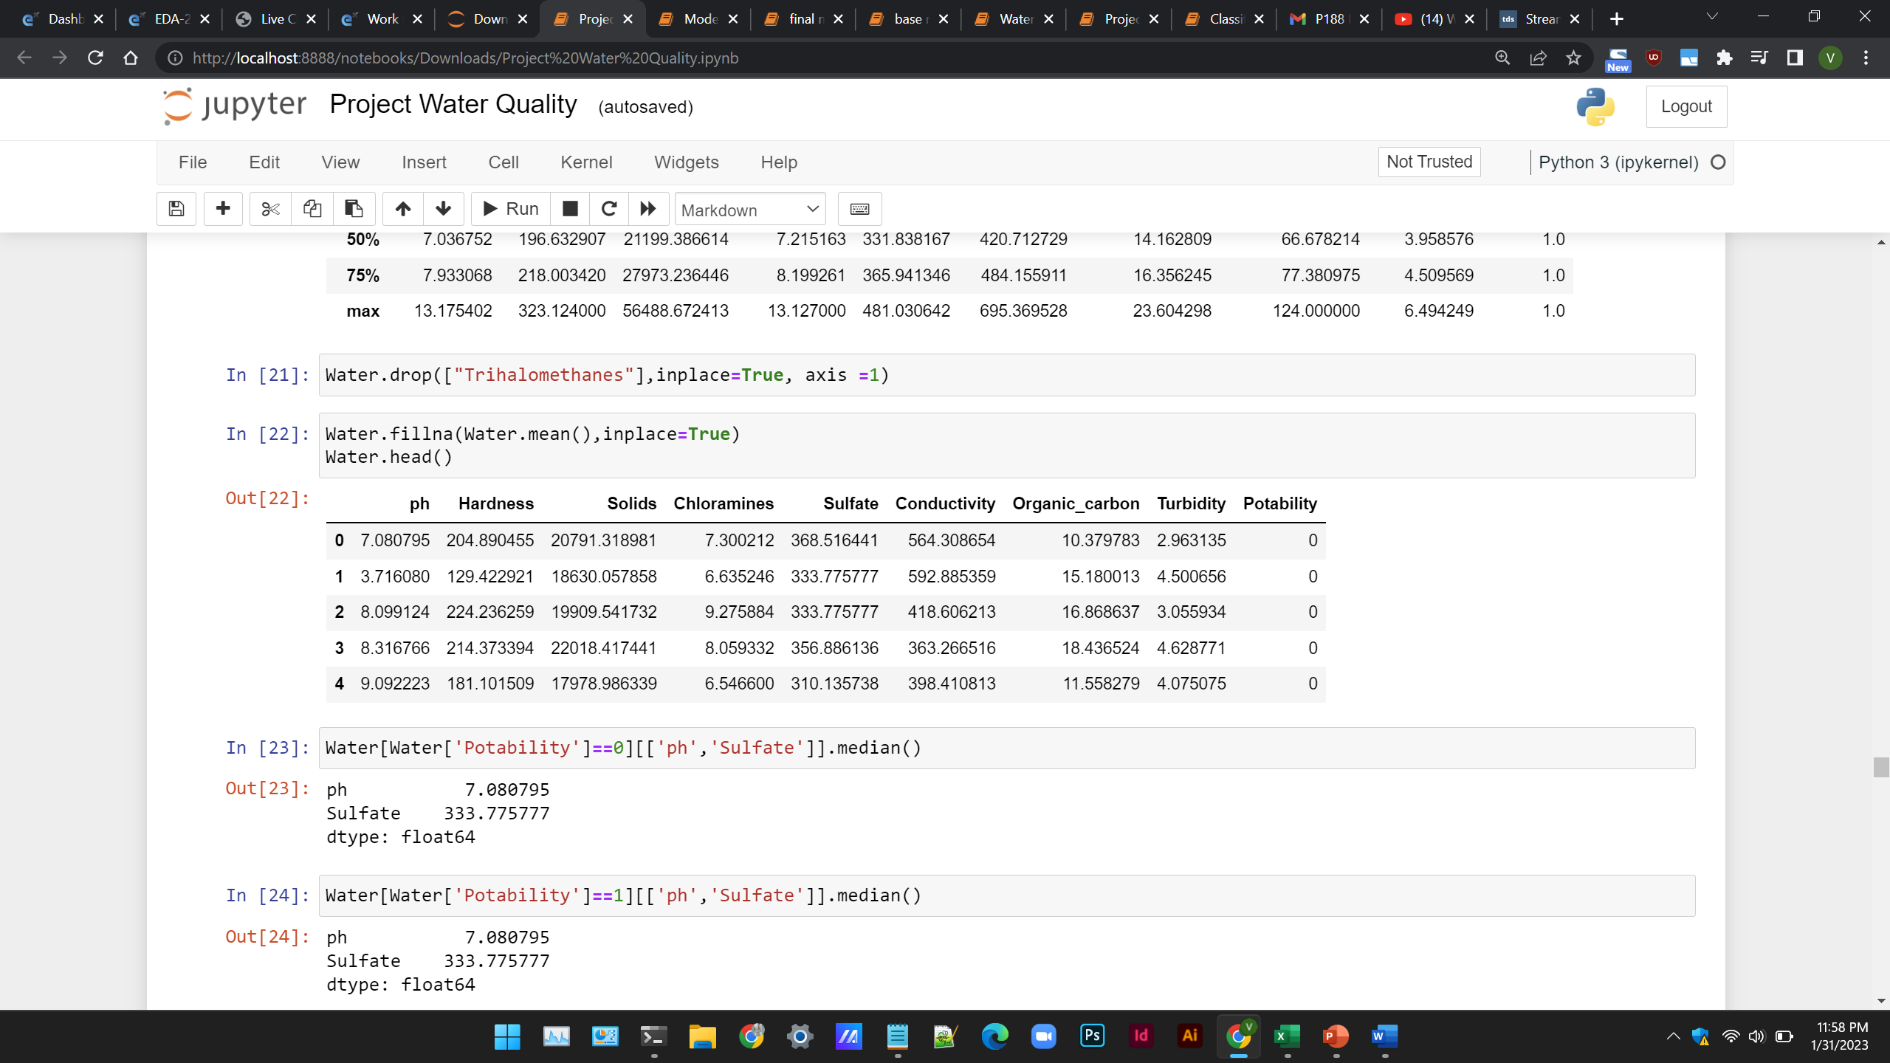
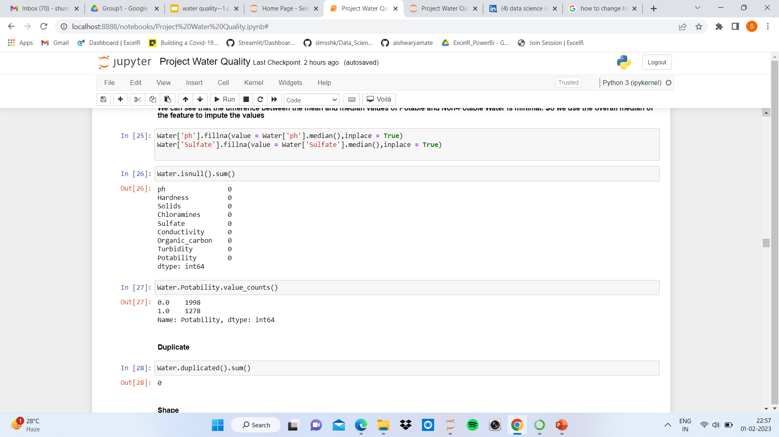

Slide 13
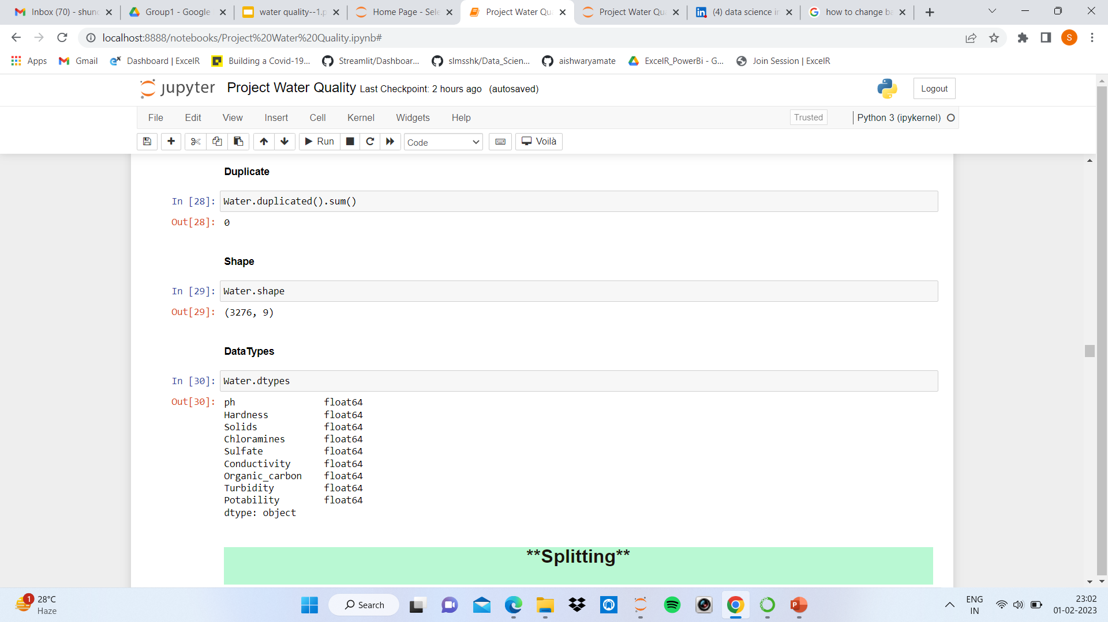
We can see that the difference between the mean and median values of Potable and Non-Potable Water is minimal. So we use the overall median of the feature to impute the values

Slide 14
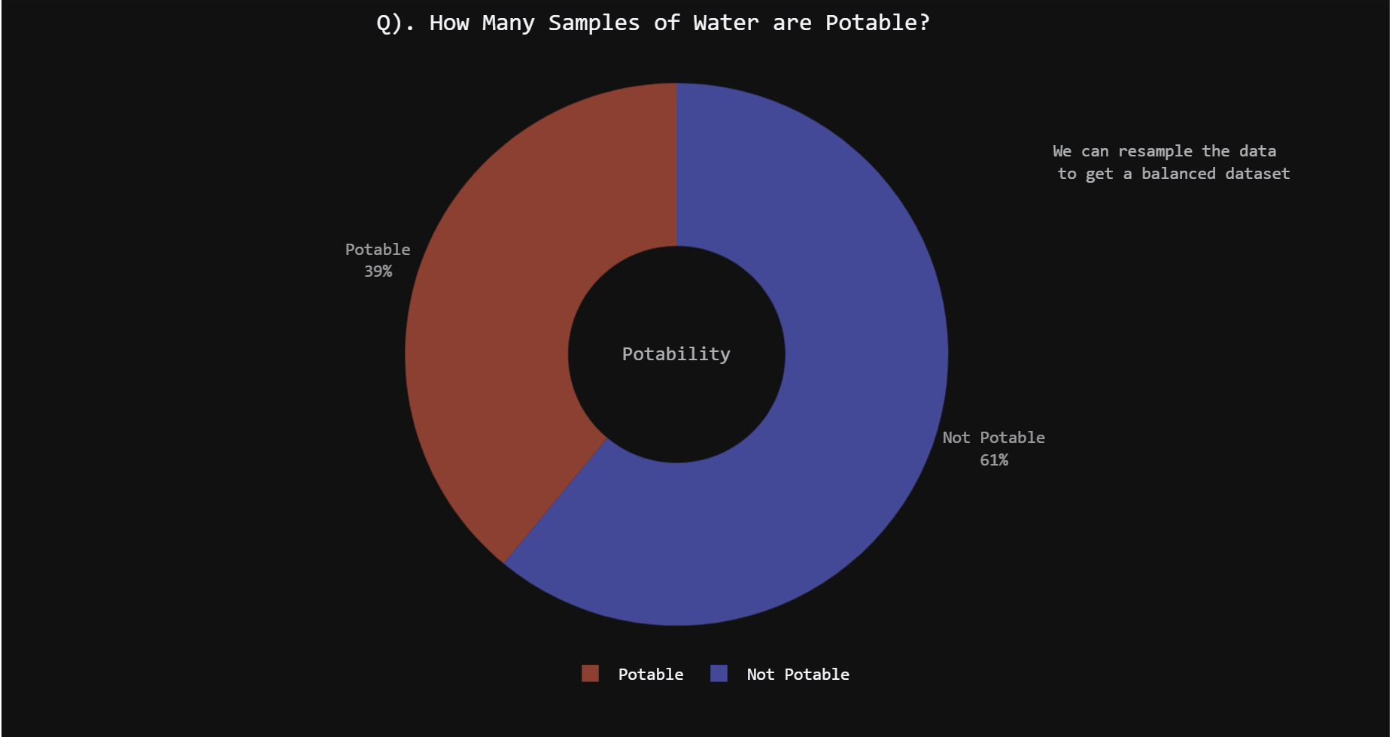
Data Visualization

Slide 15
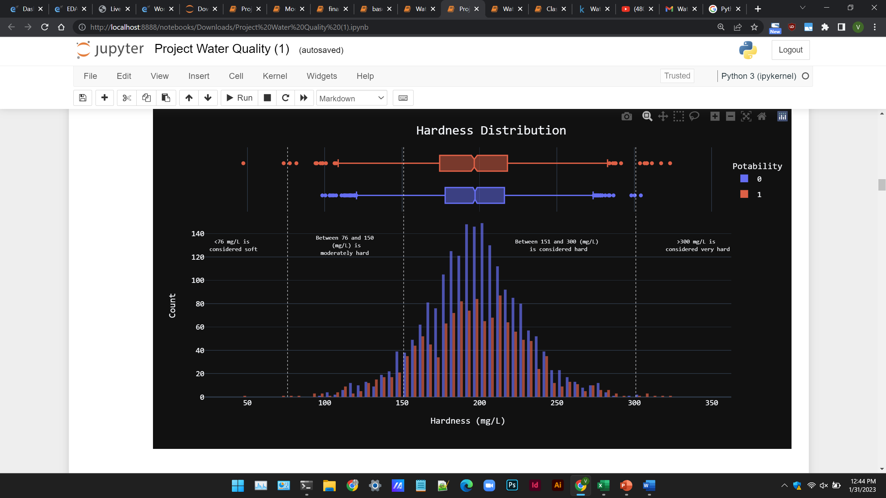

Slide 16
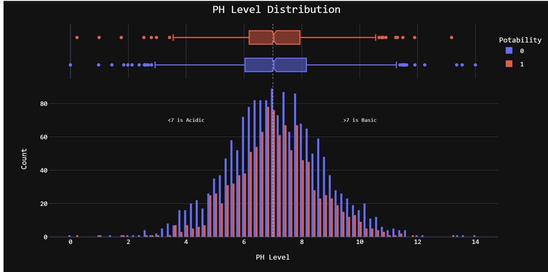

Slide 17
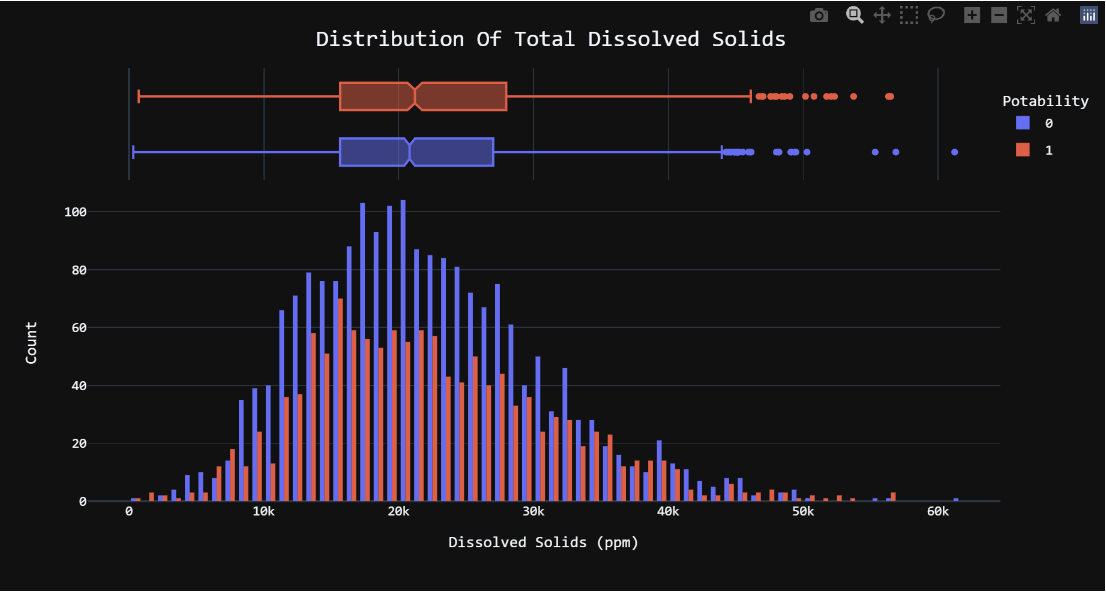

Slide 18
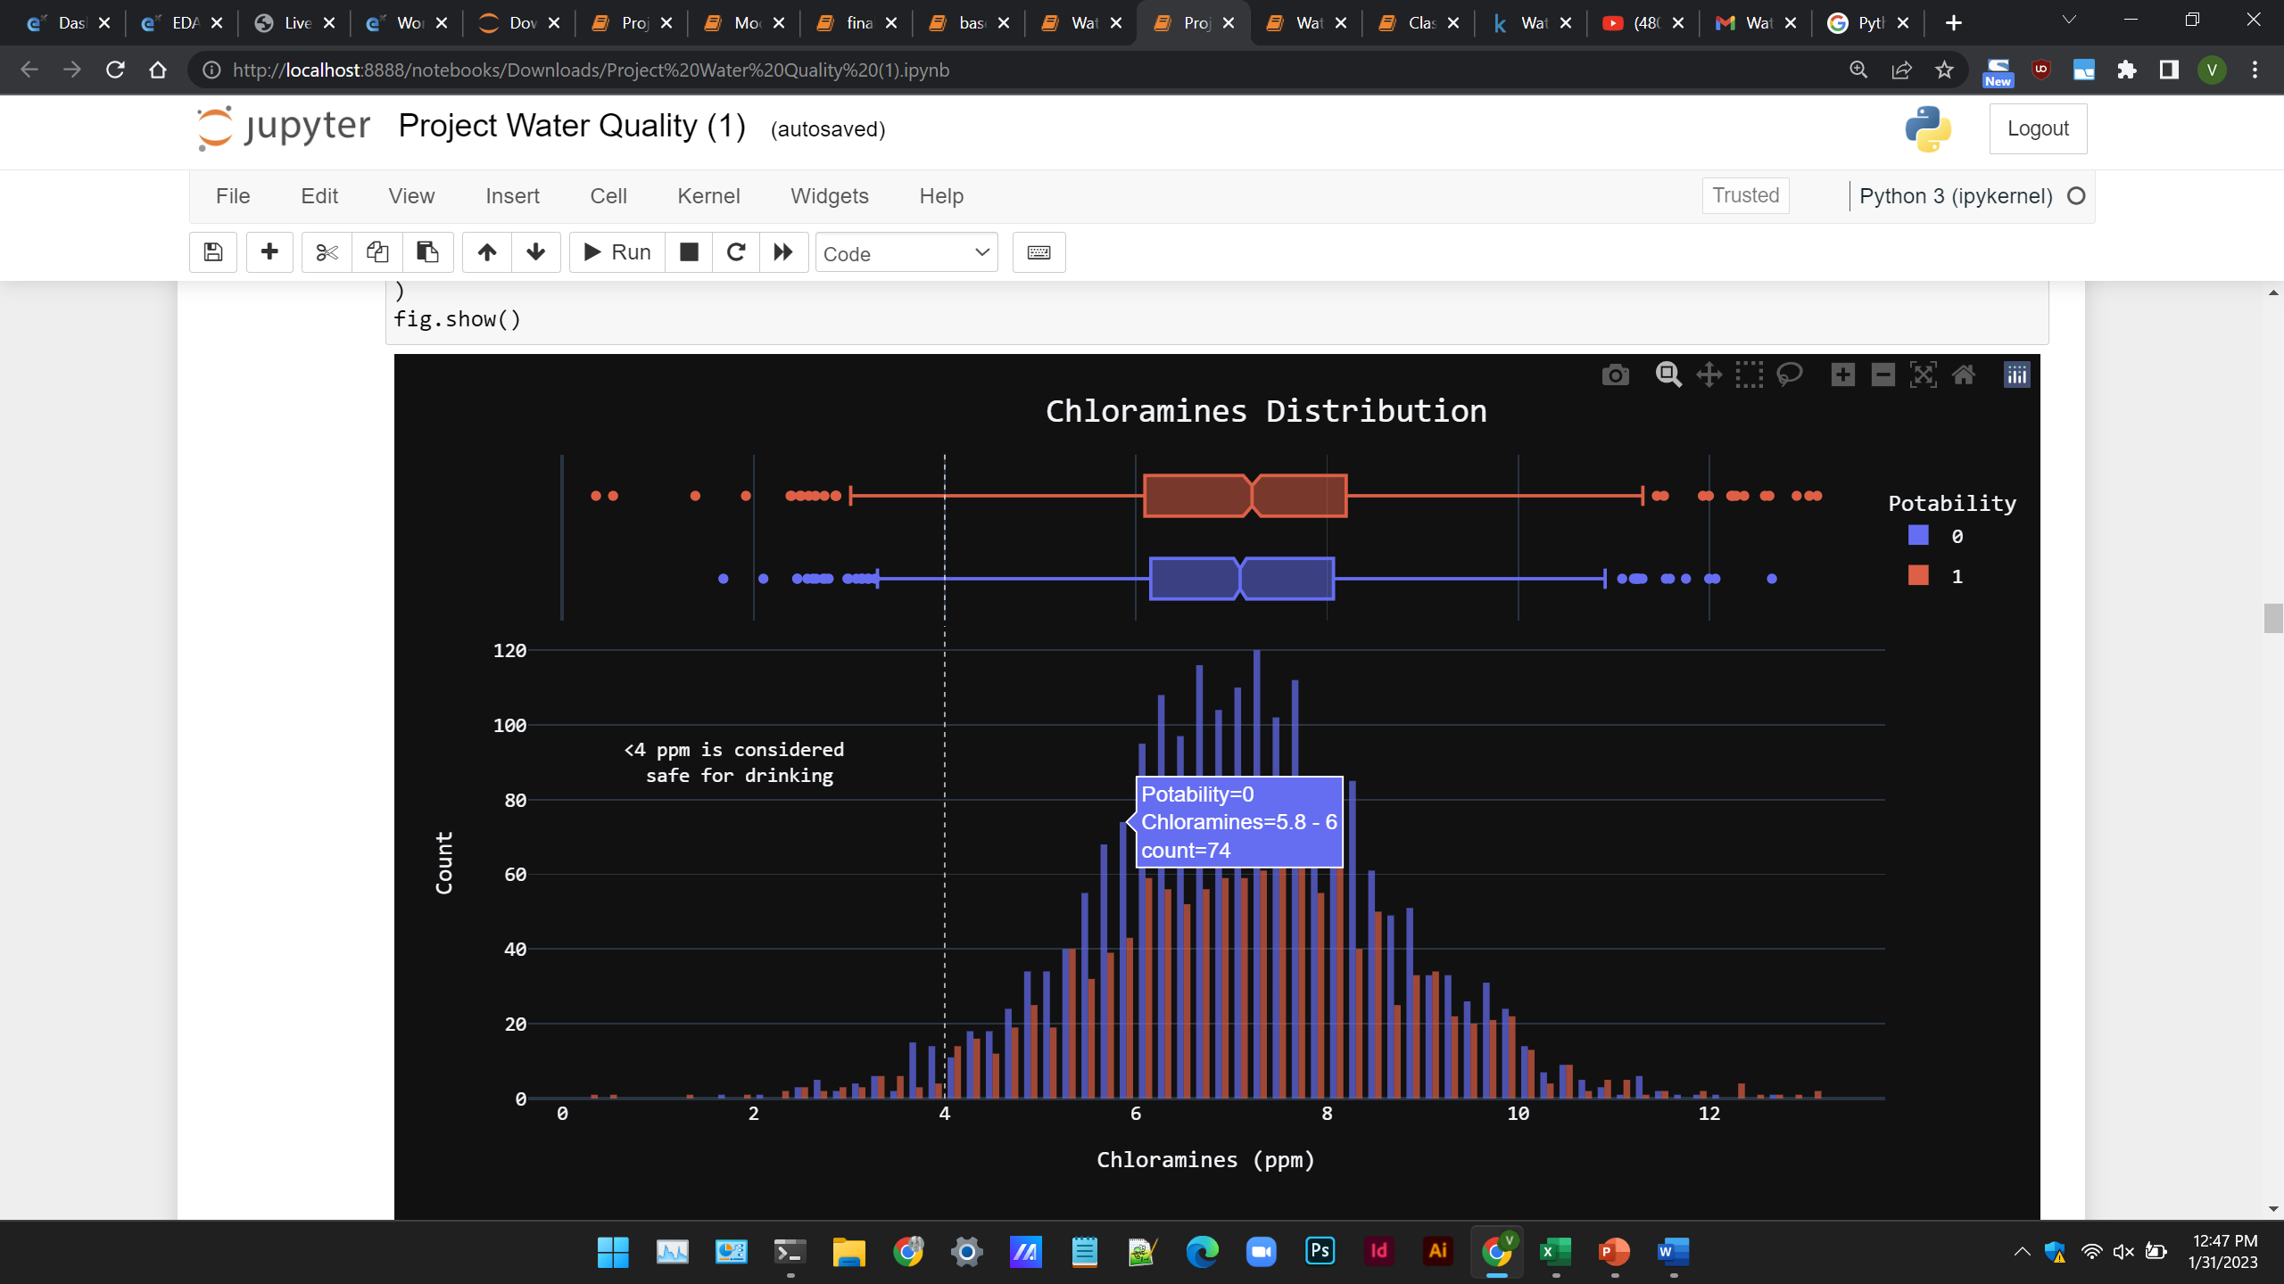

Slide 19
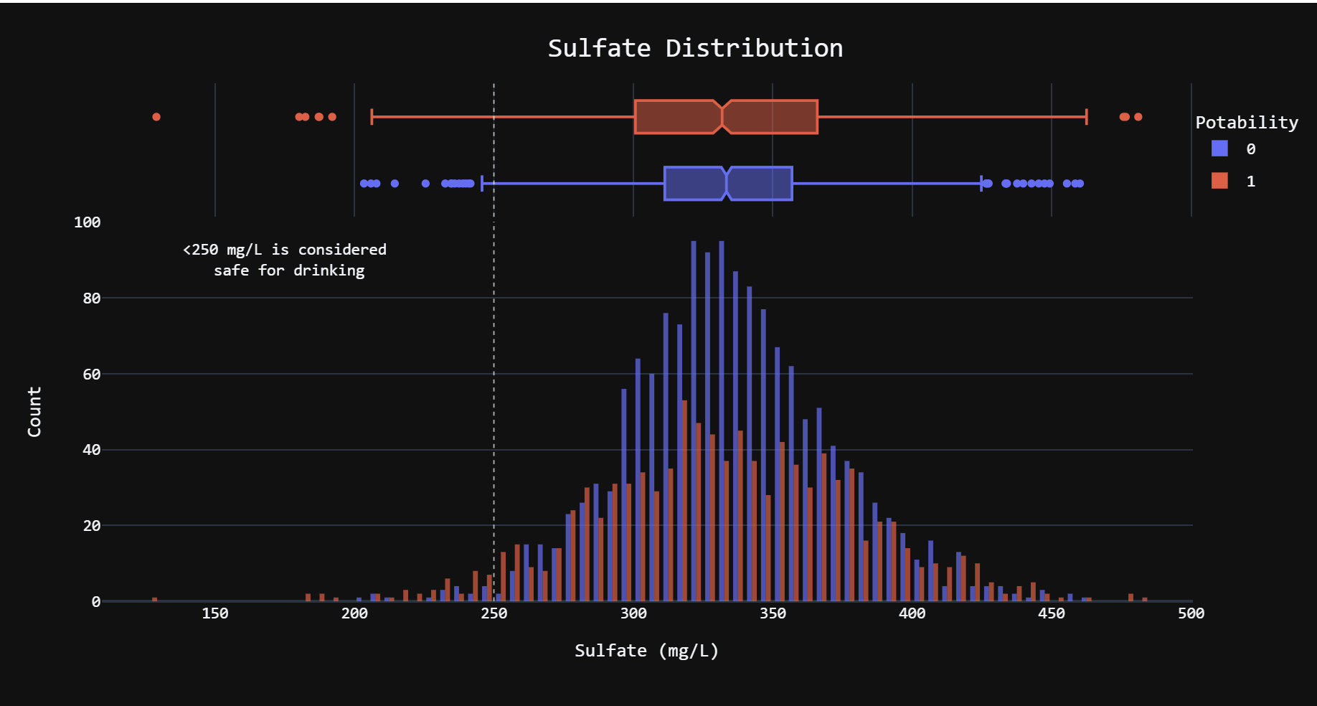

Slide 20
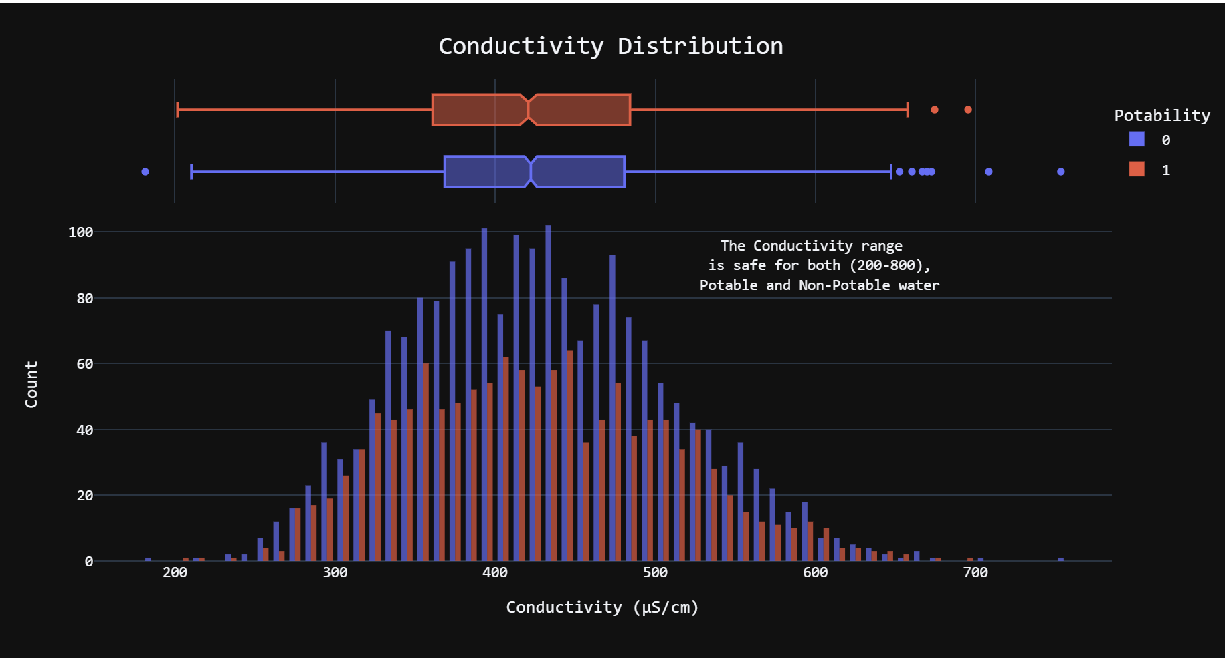

Slide 21
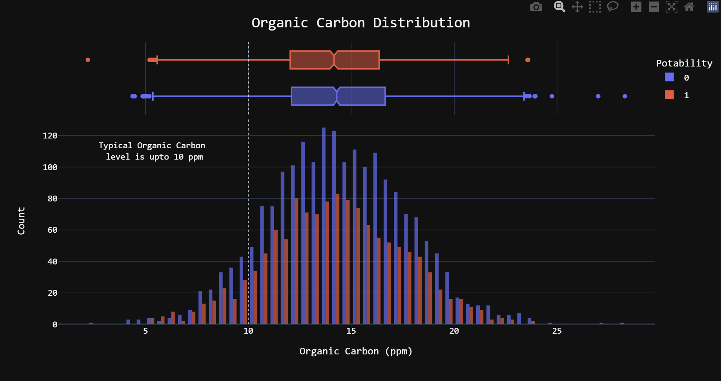

Slide 22
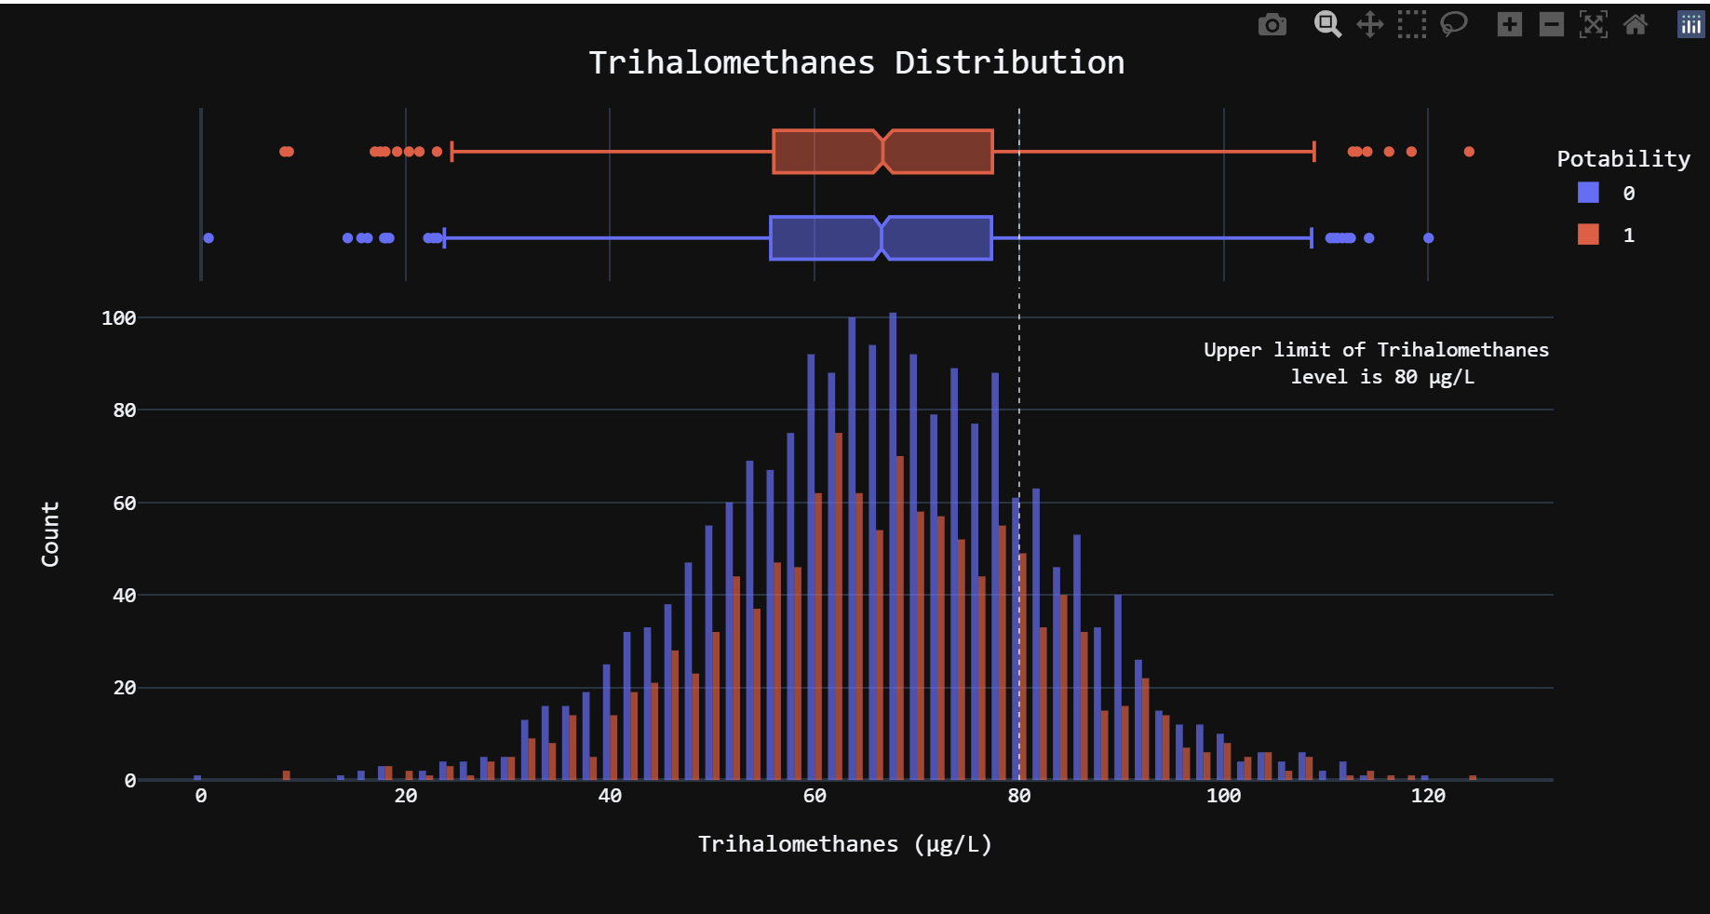

Slide 23
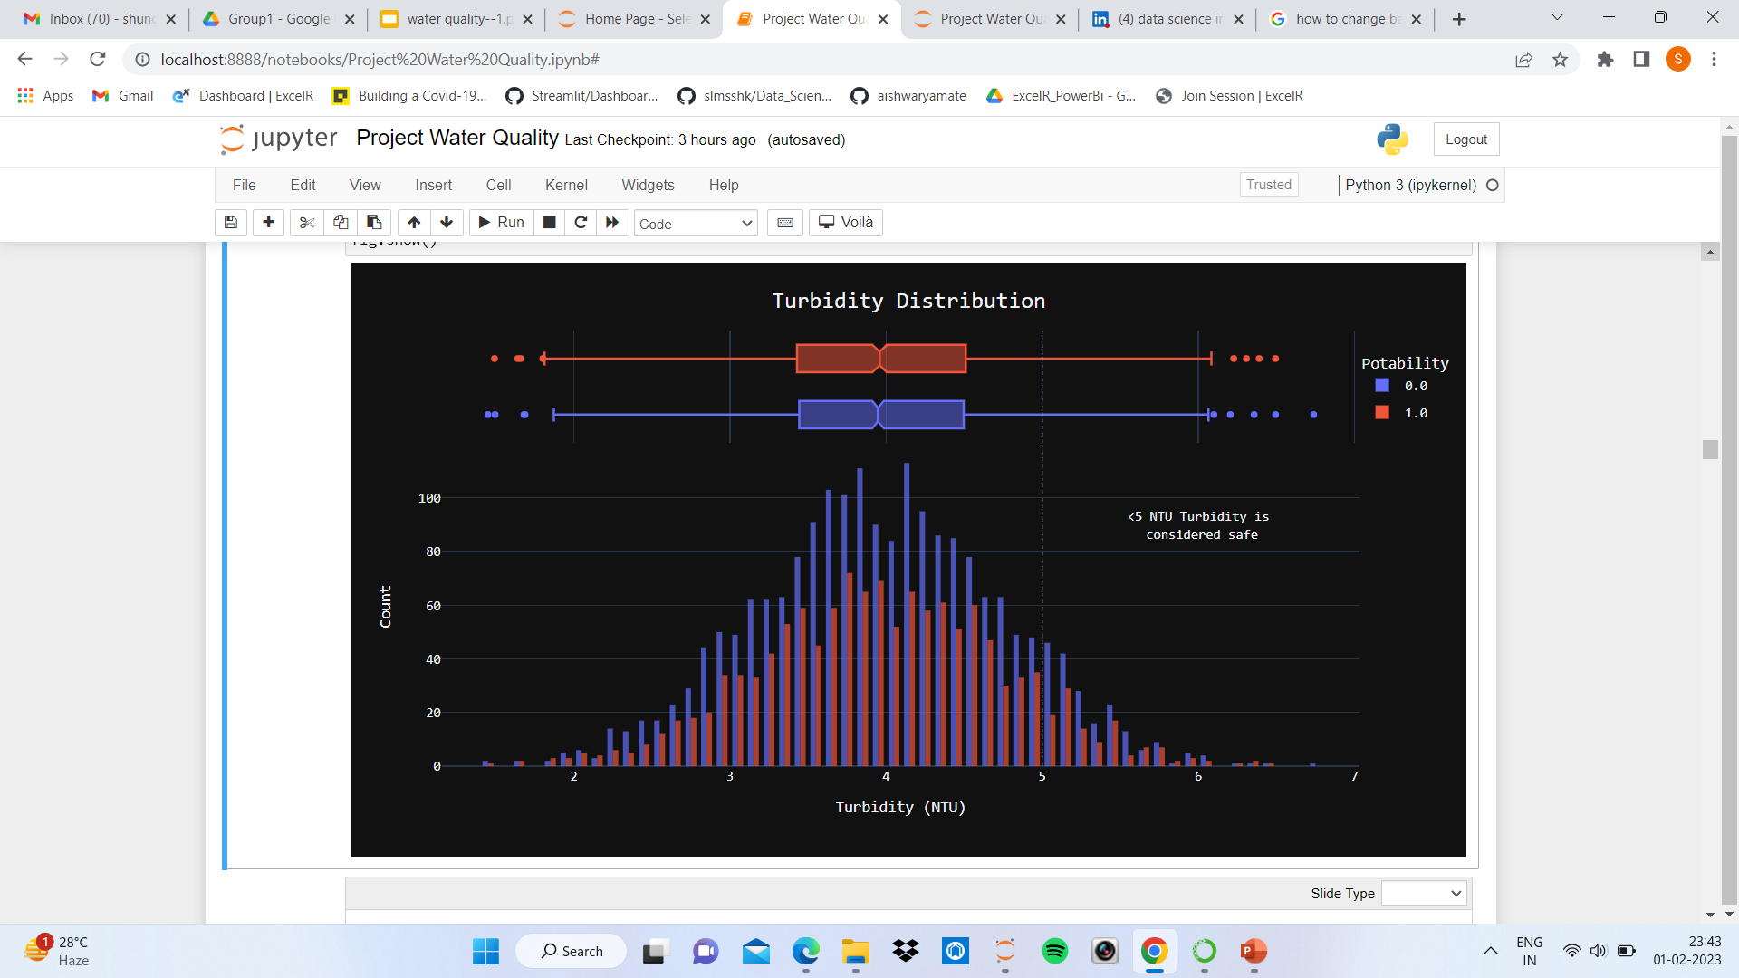

Slide 24
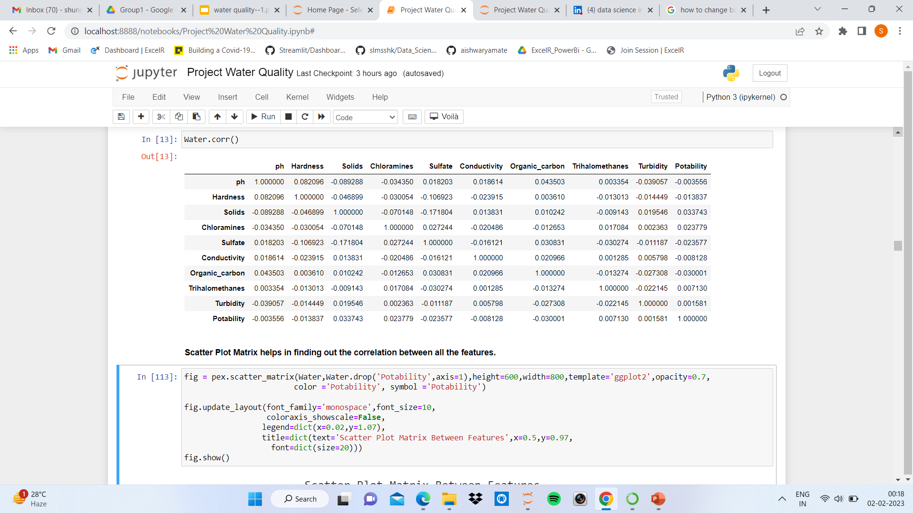
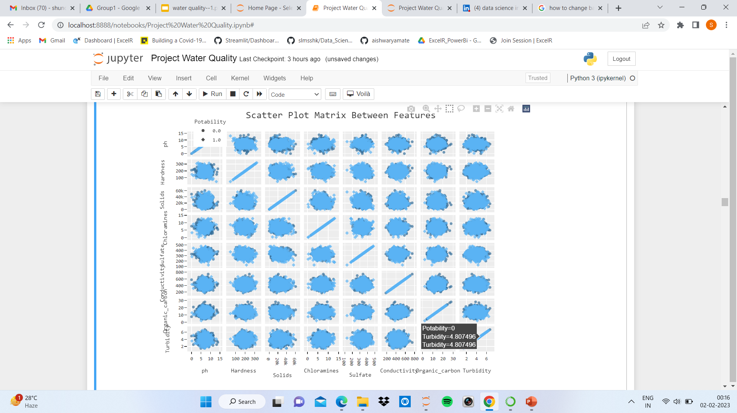

Slide 25
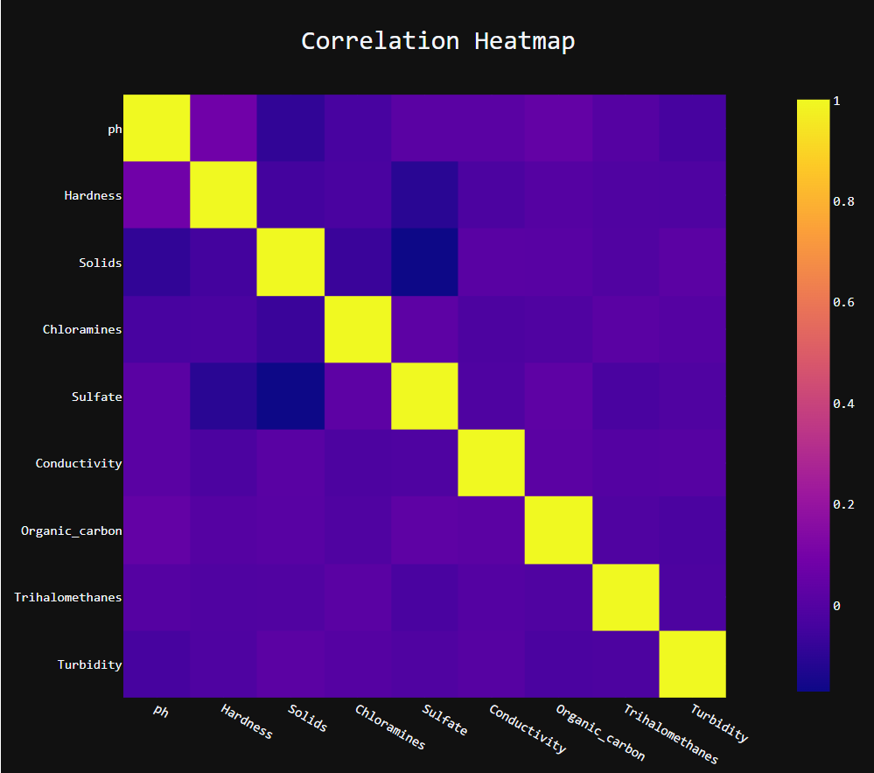

Slide 26
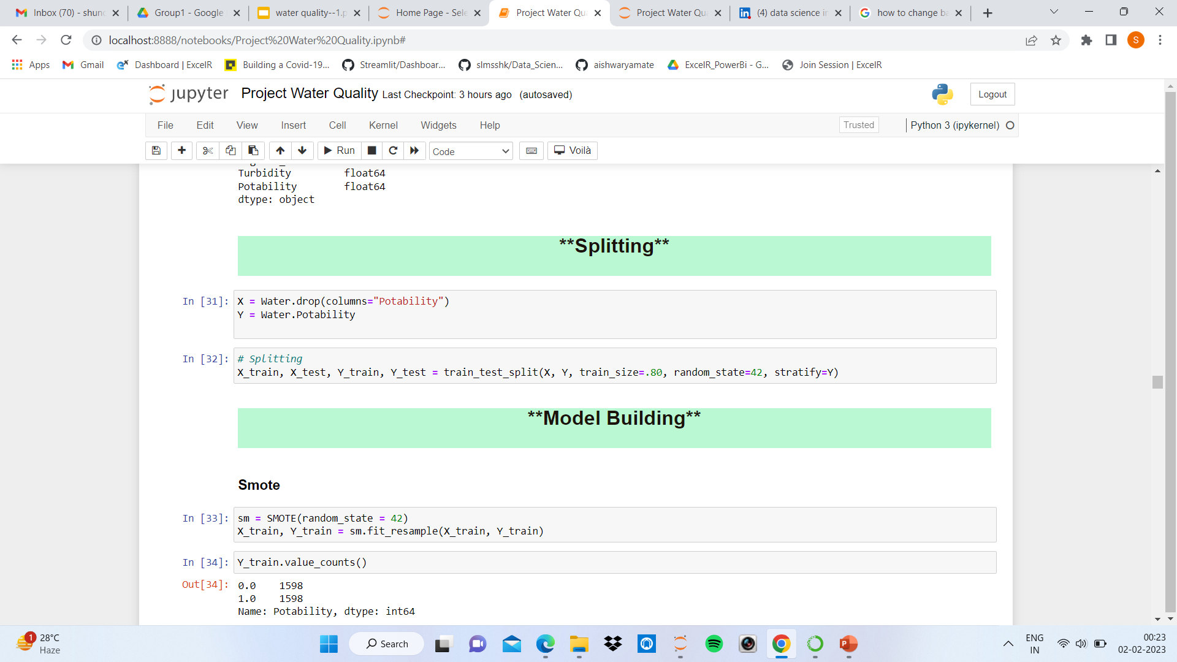
Standardizing the Data
Splitting

Slide 27
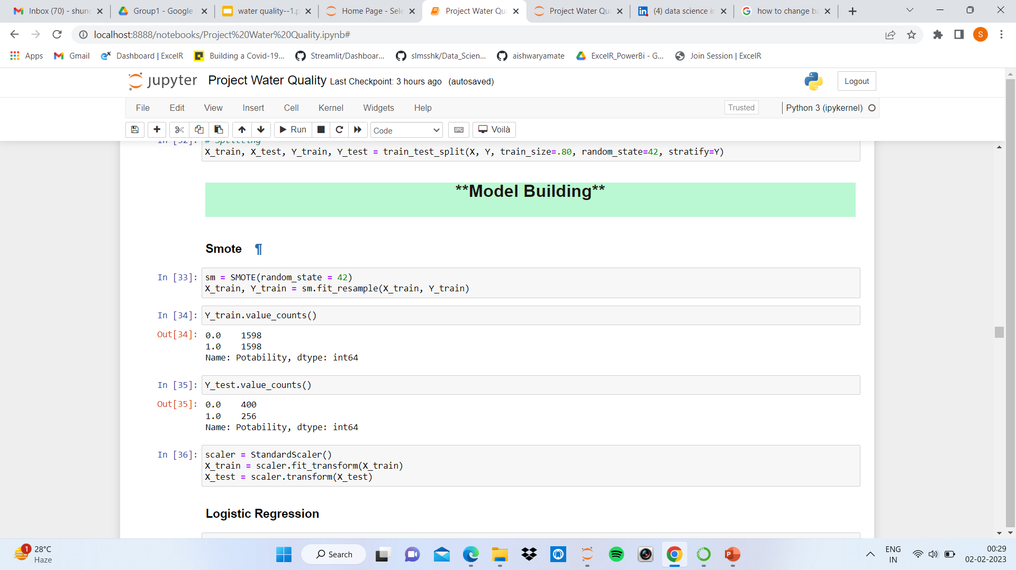
Model Building

Slide 28
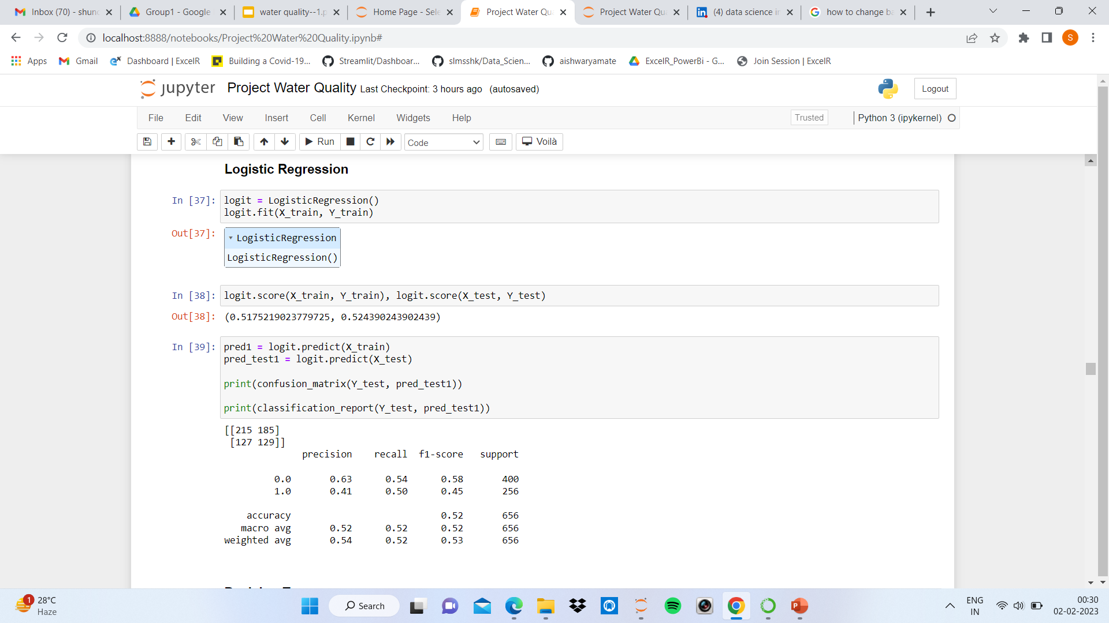

Slide 29
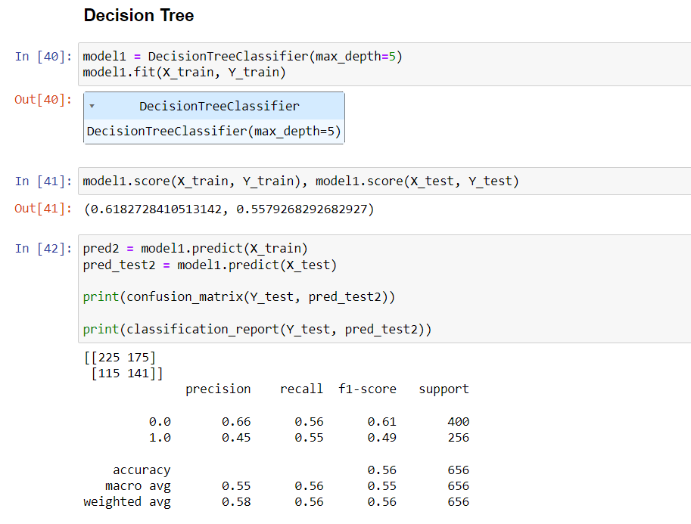

Slide 30
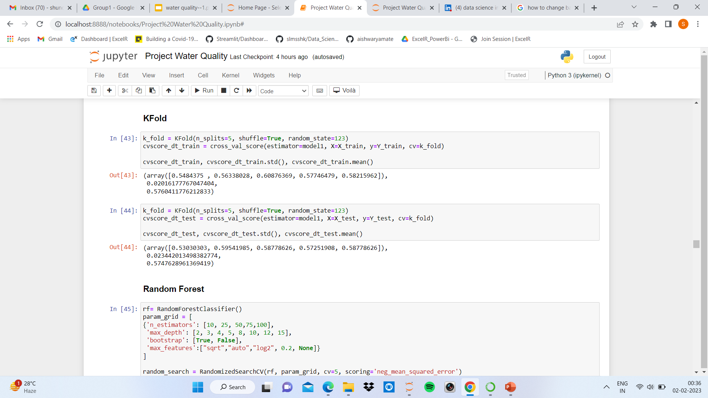

Slide 31
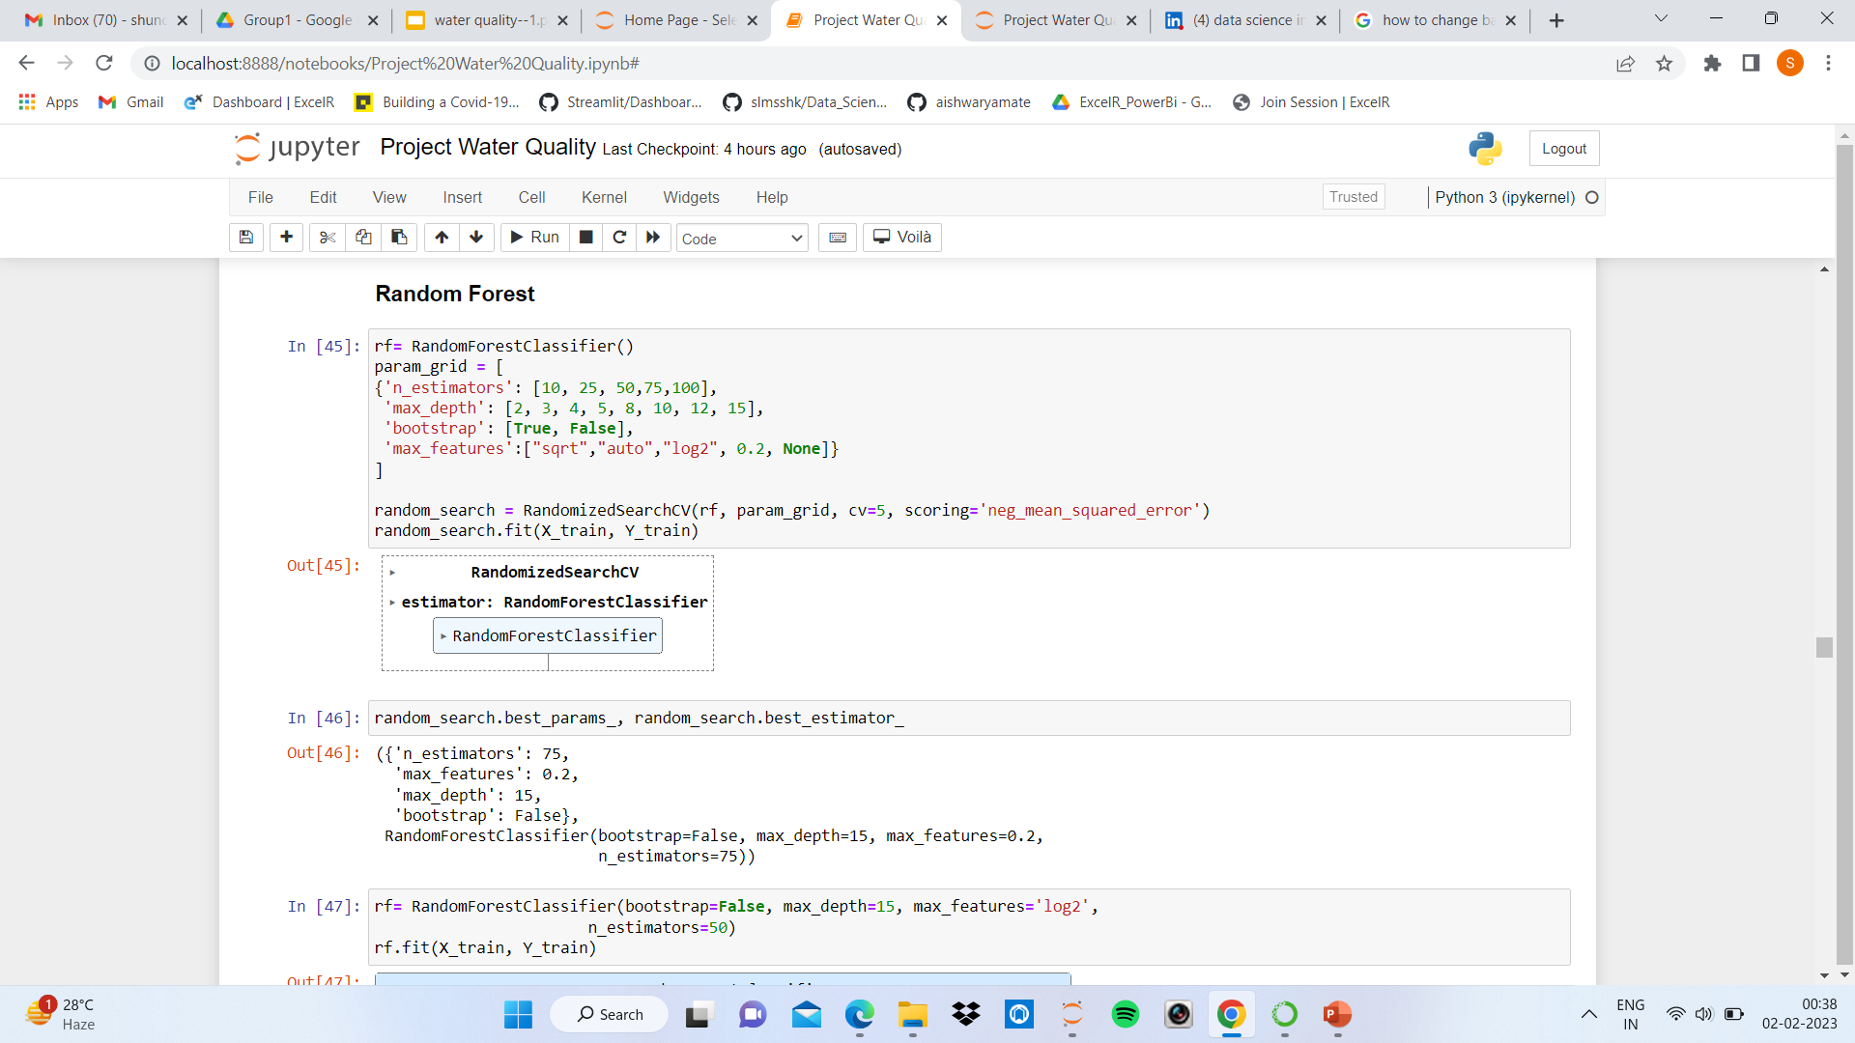
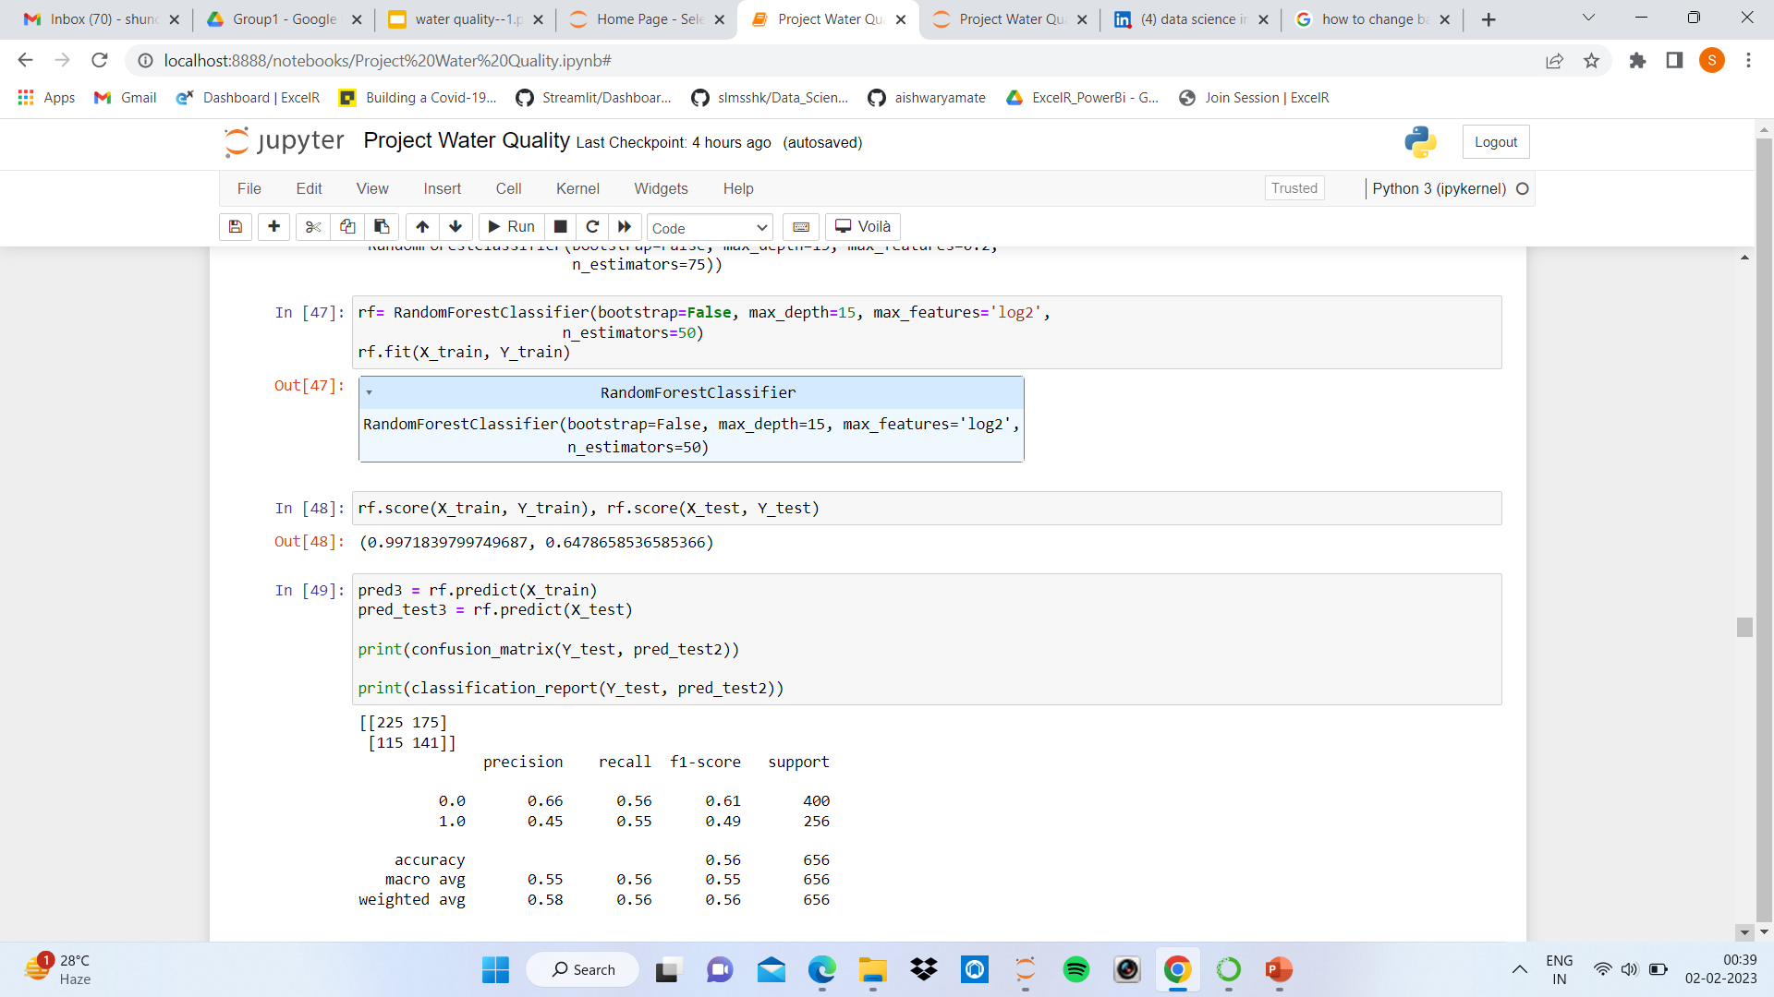

Slide 32
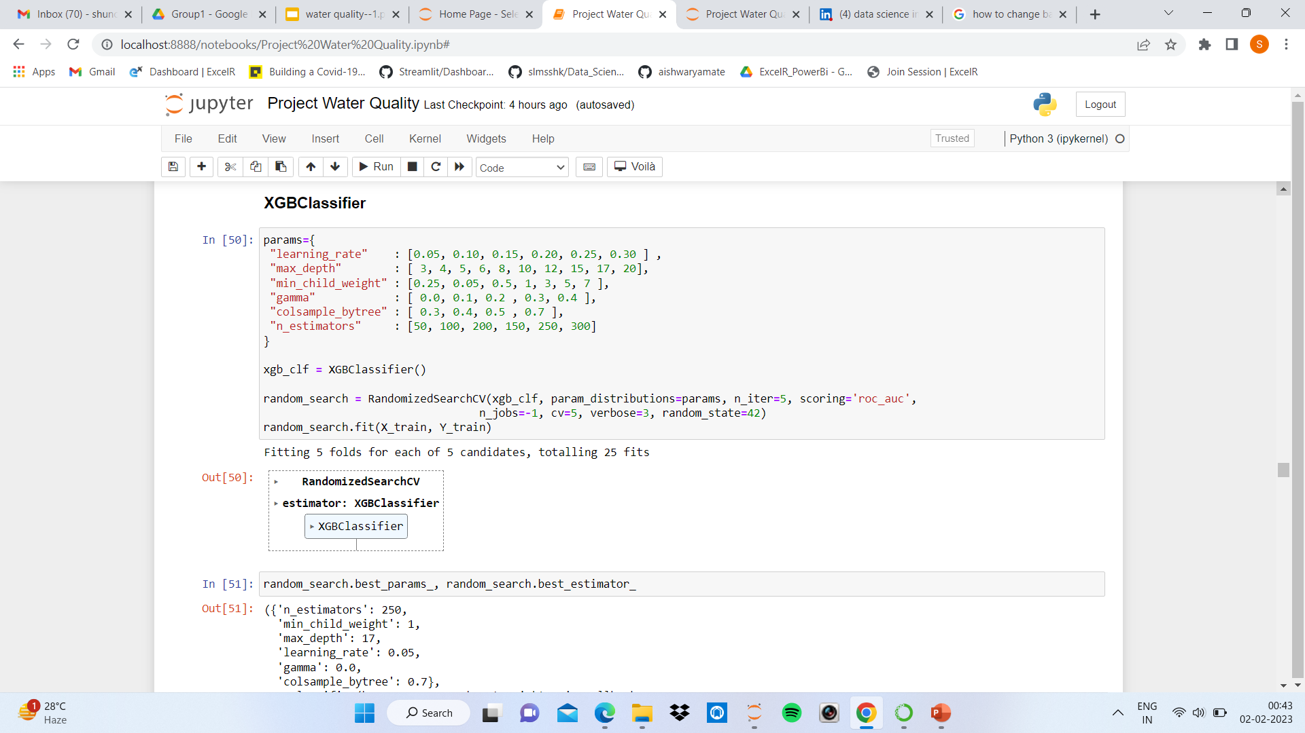
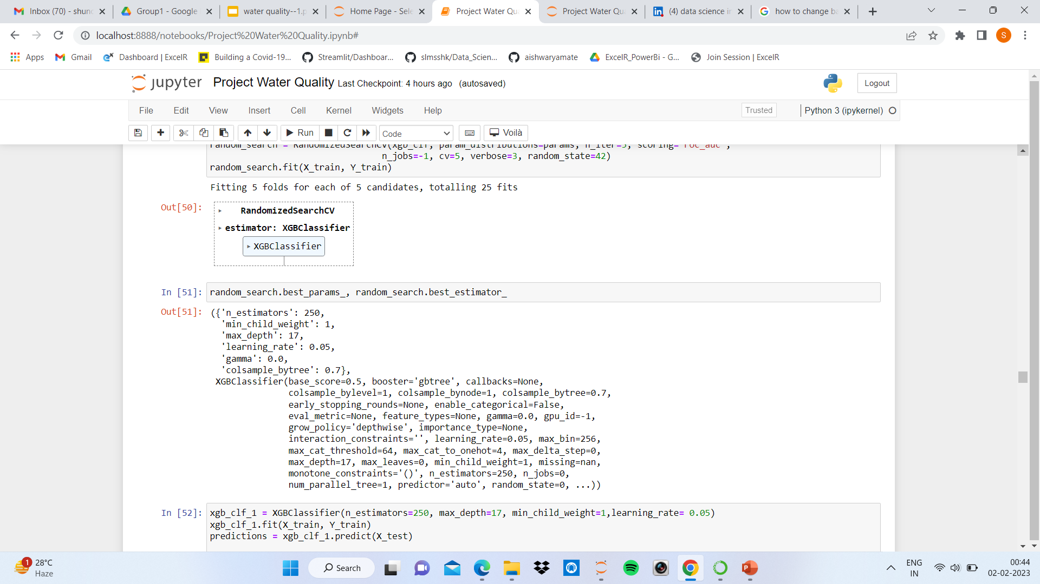

Slide 33
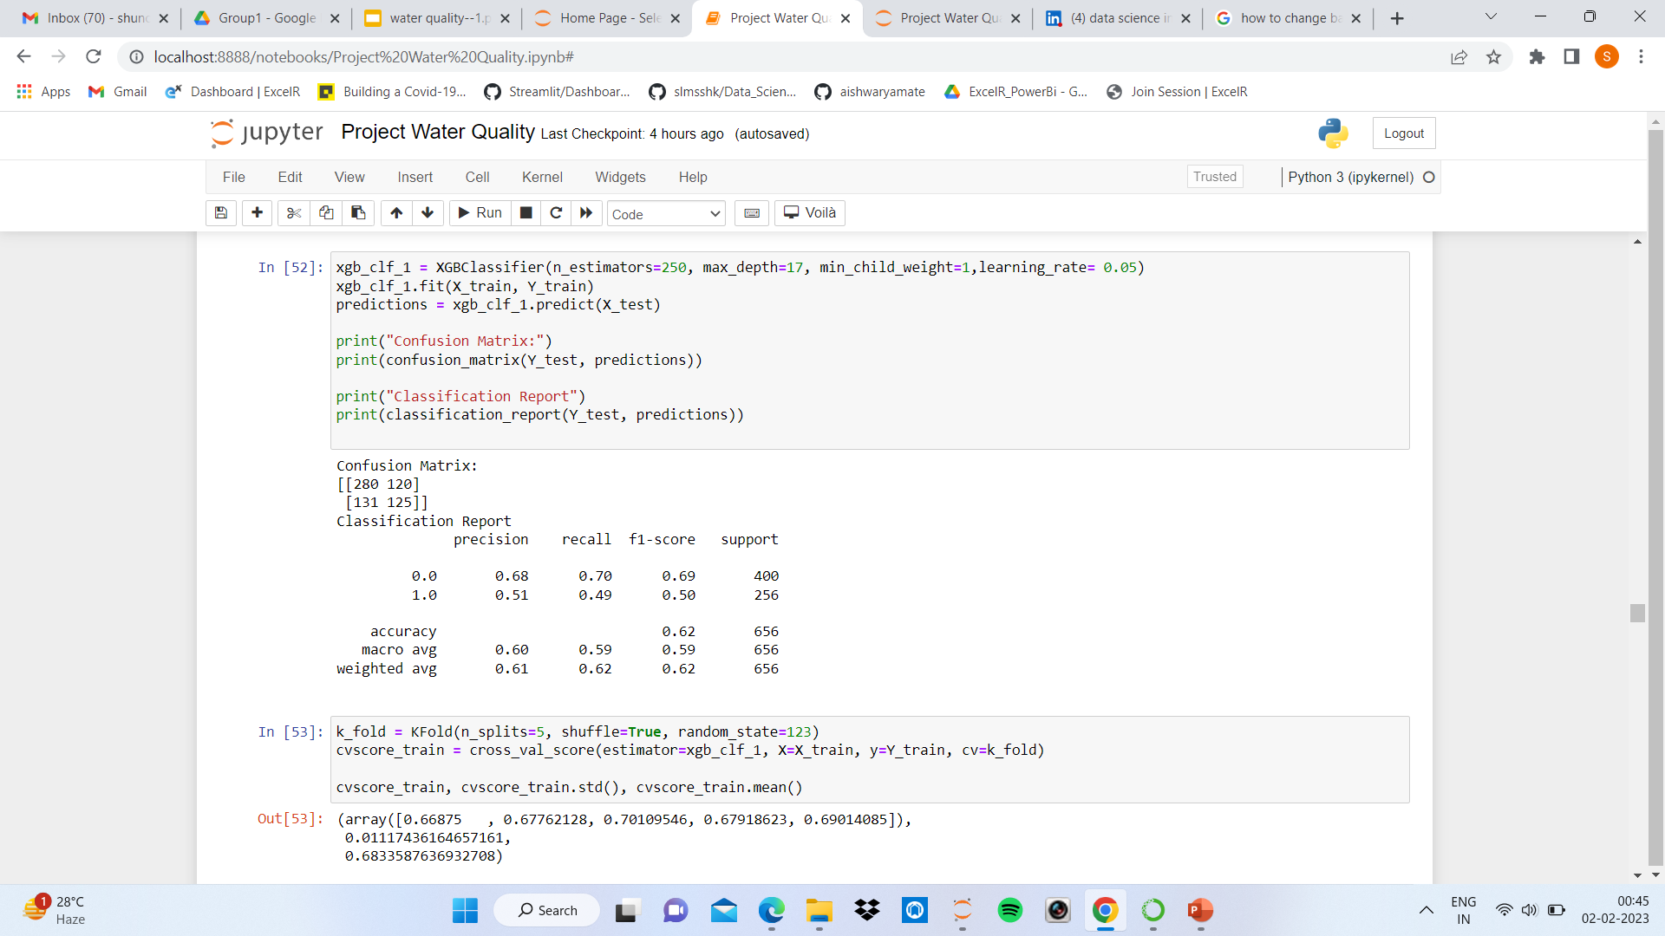
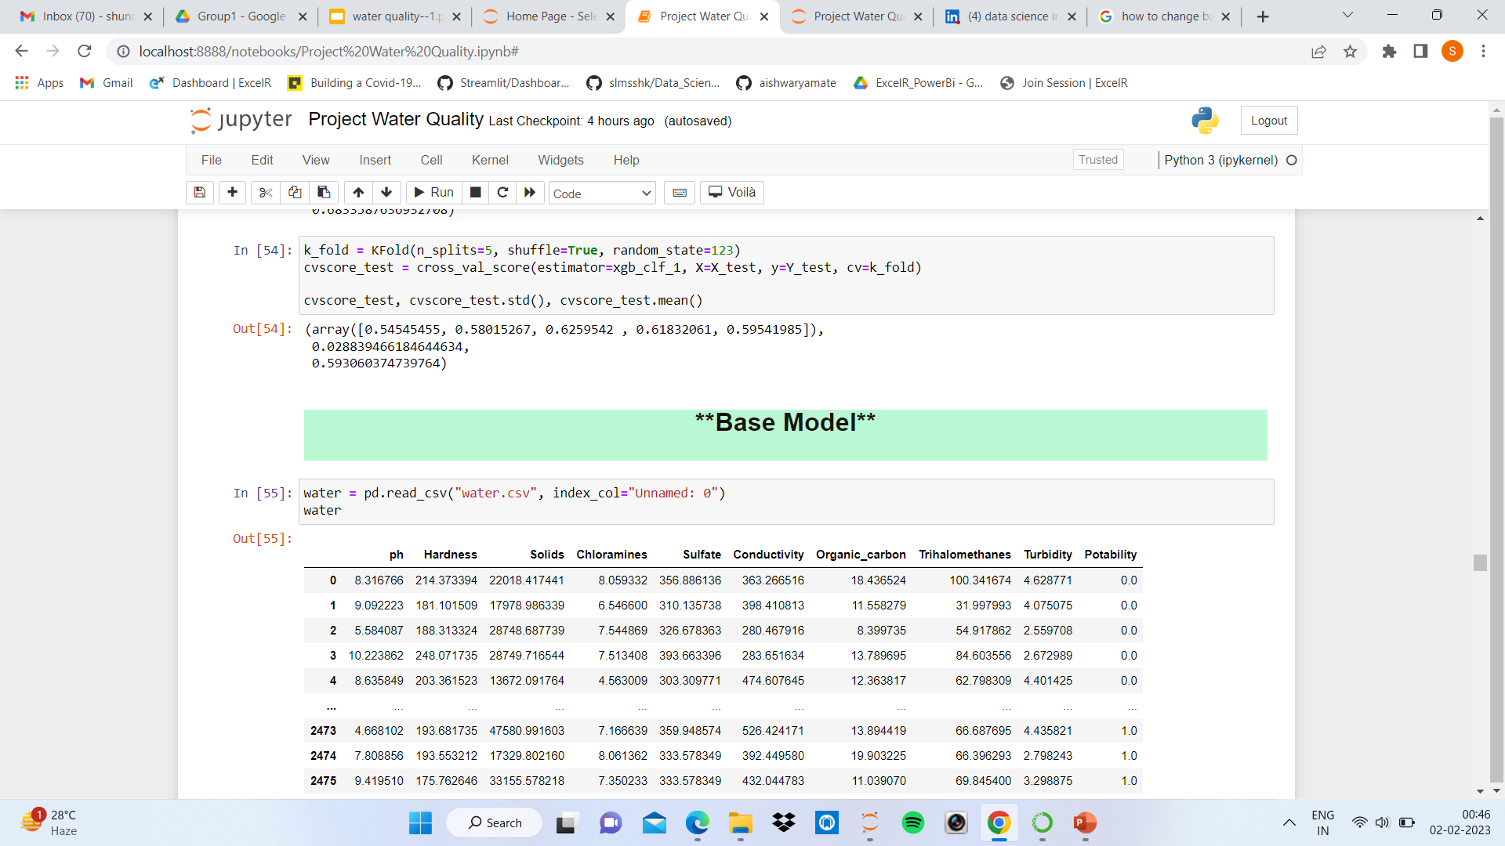

Slide 34
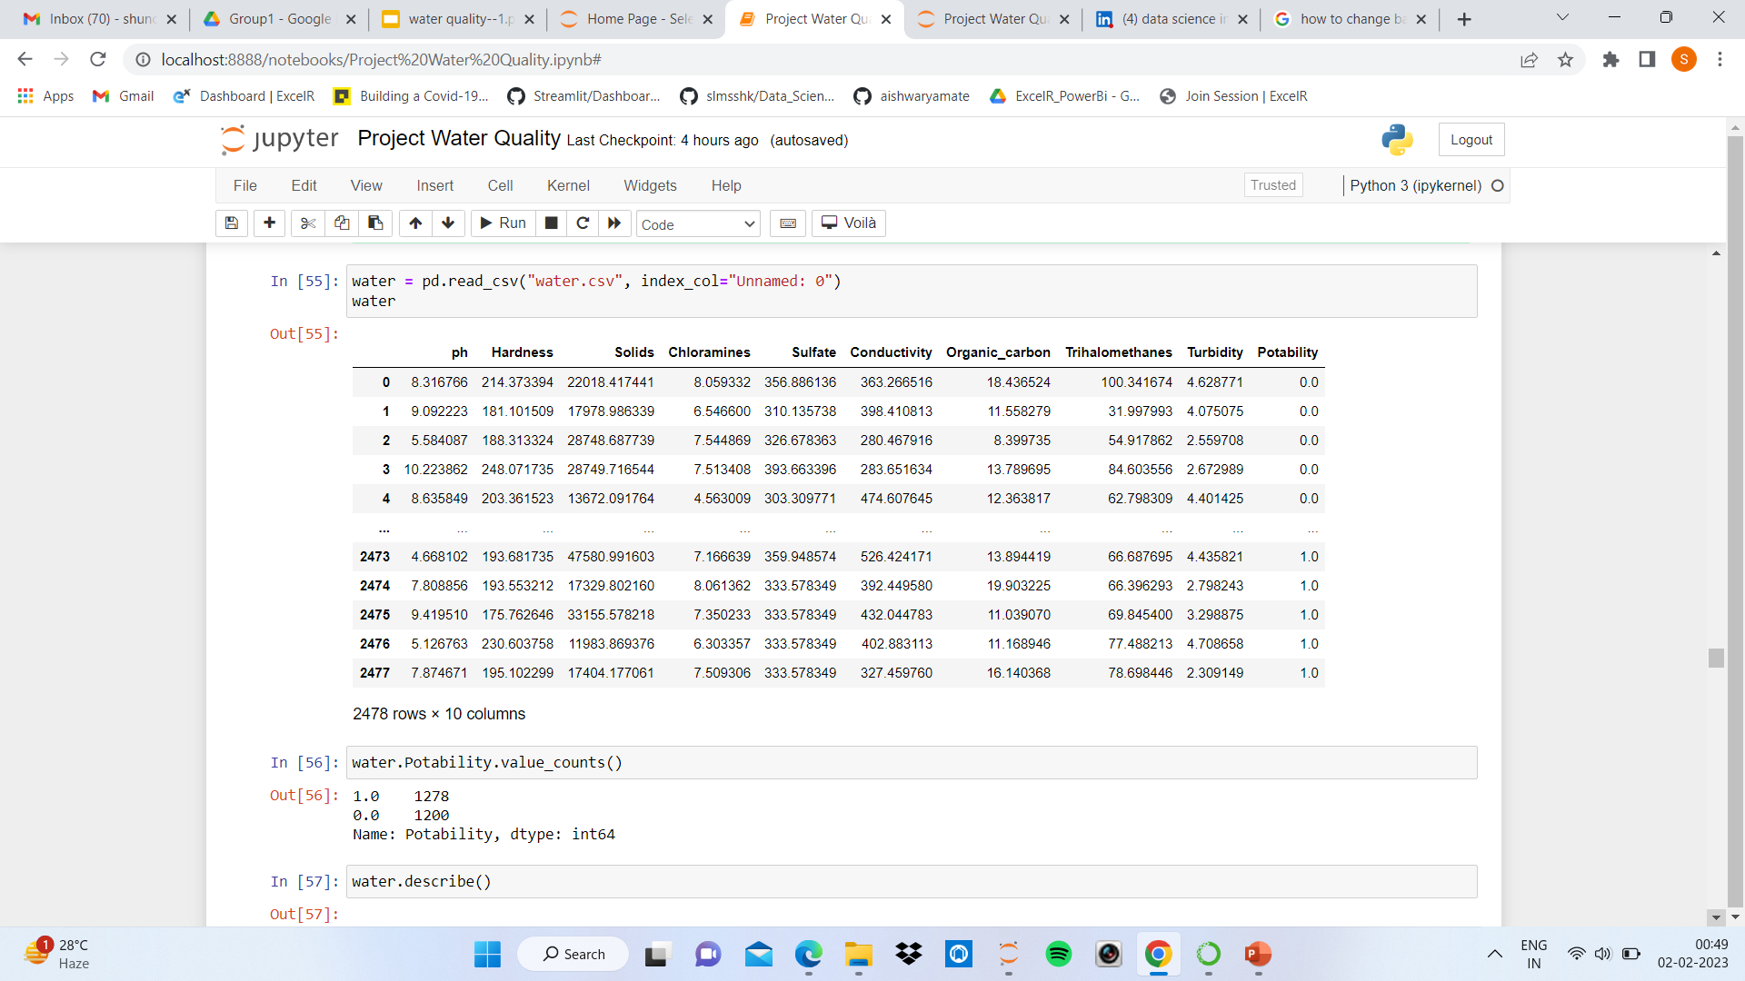
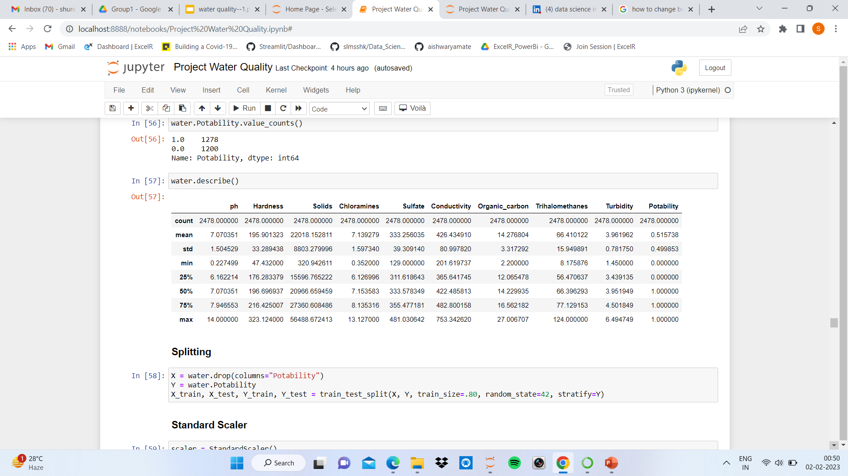
Base Model

Slide 35
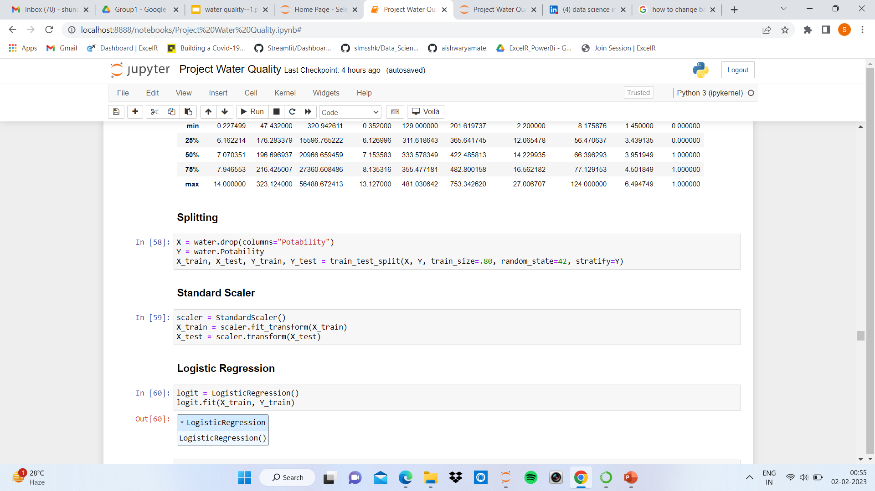
Splitting
Standard Scaler

Slide 36


Slide 37
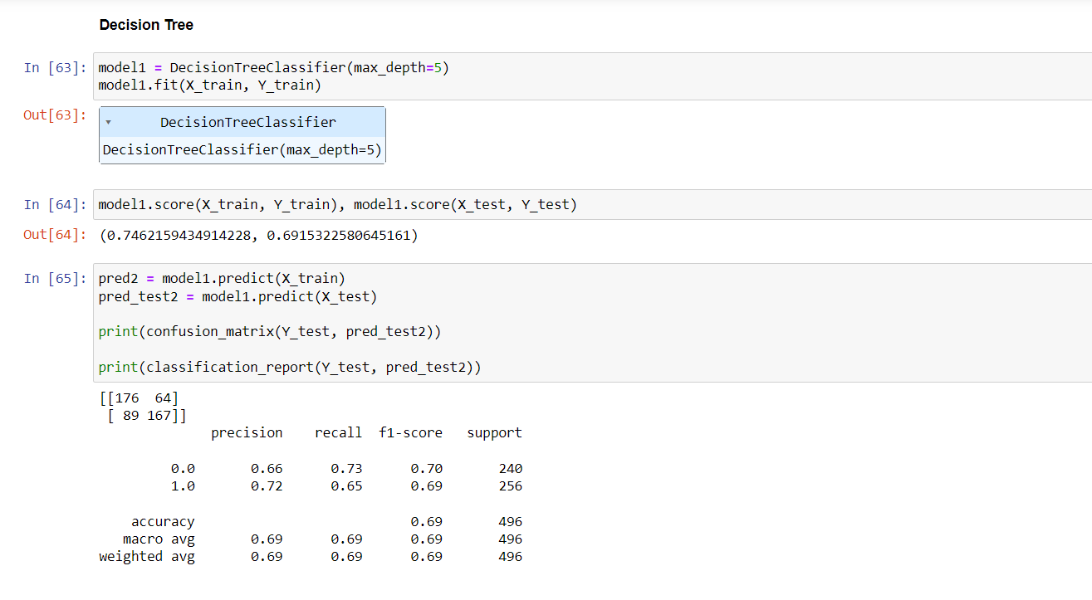

Slide 38
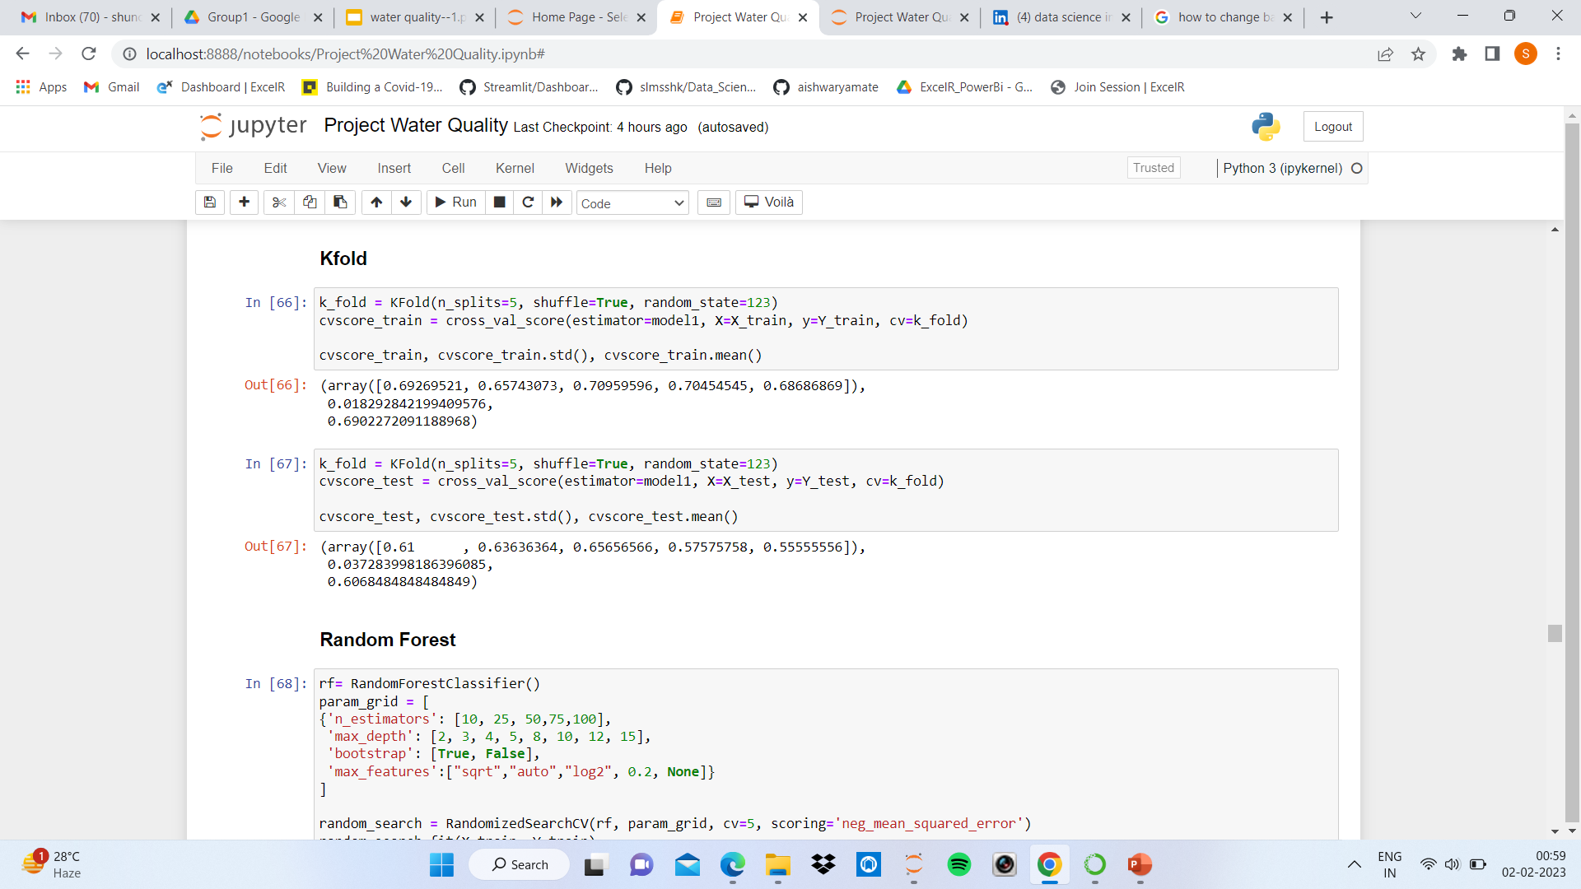

Slide 39
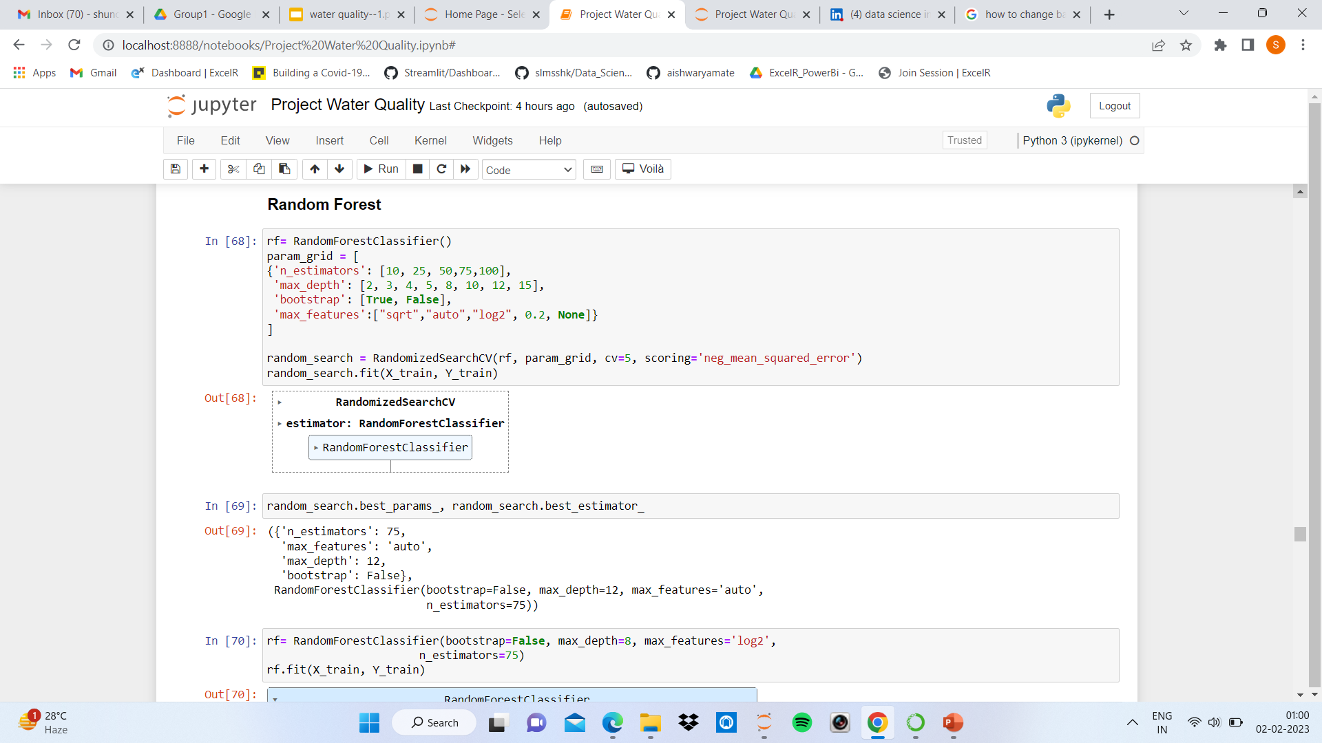
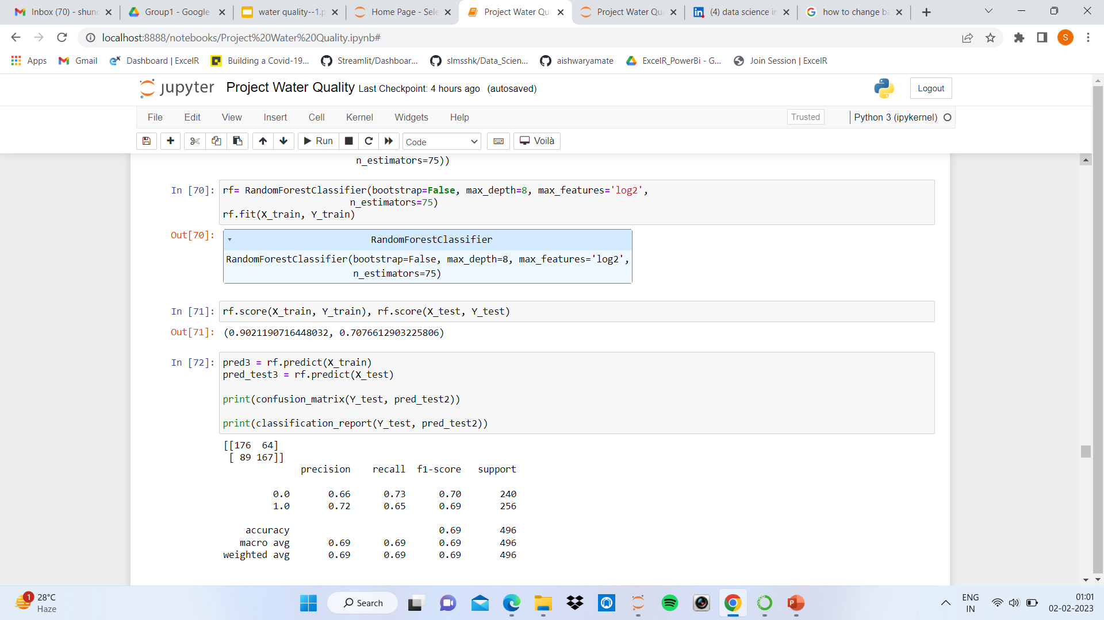

Slide 40
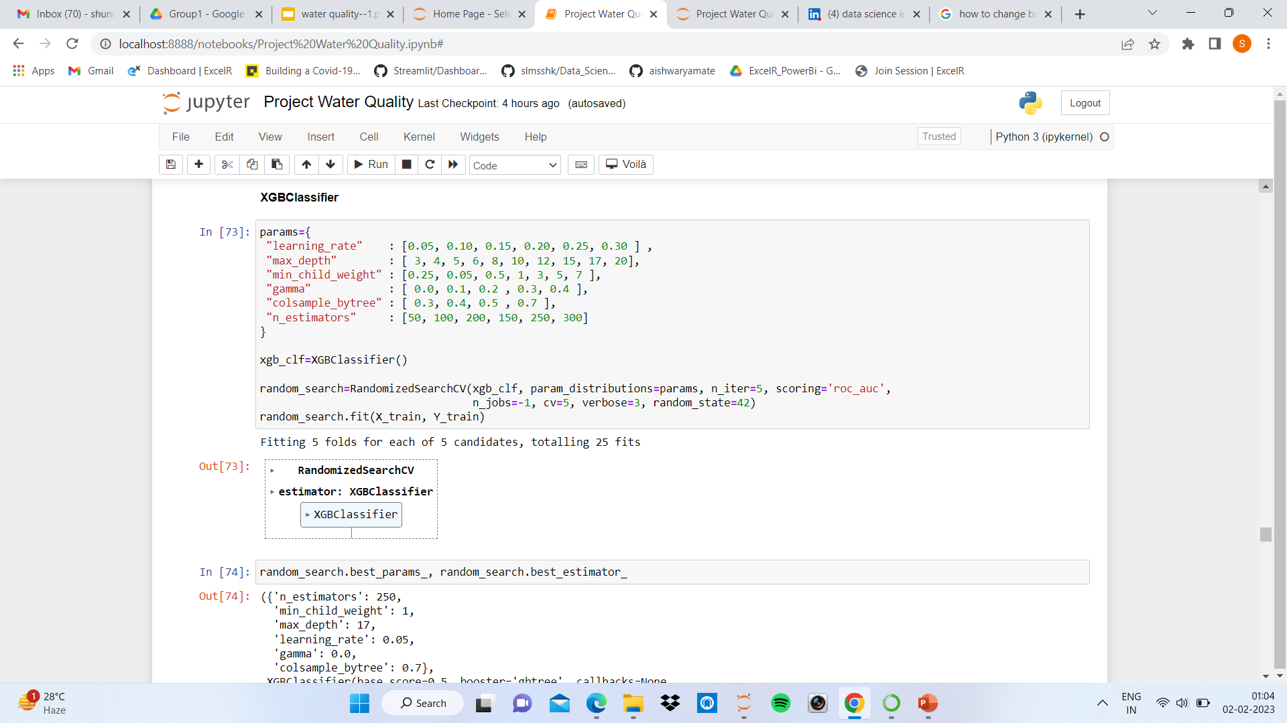

Slide 41
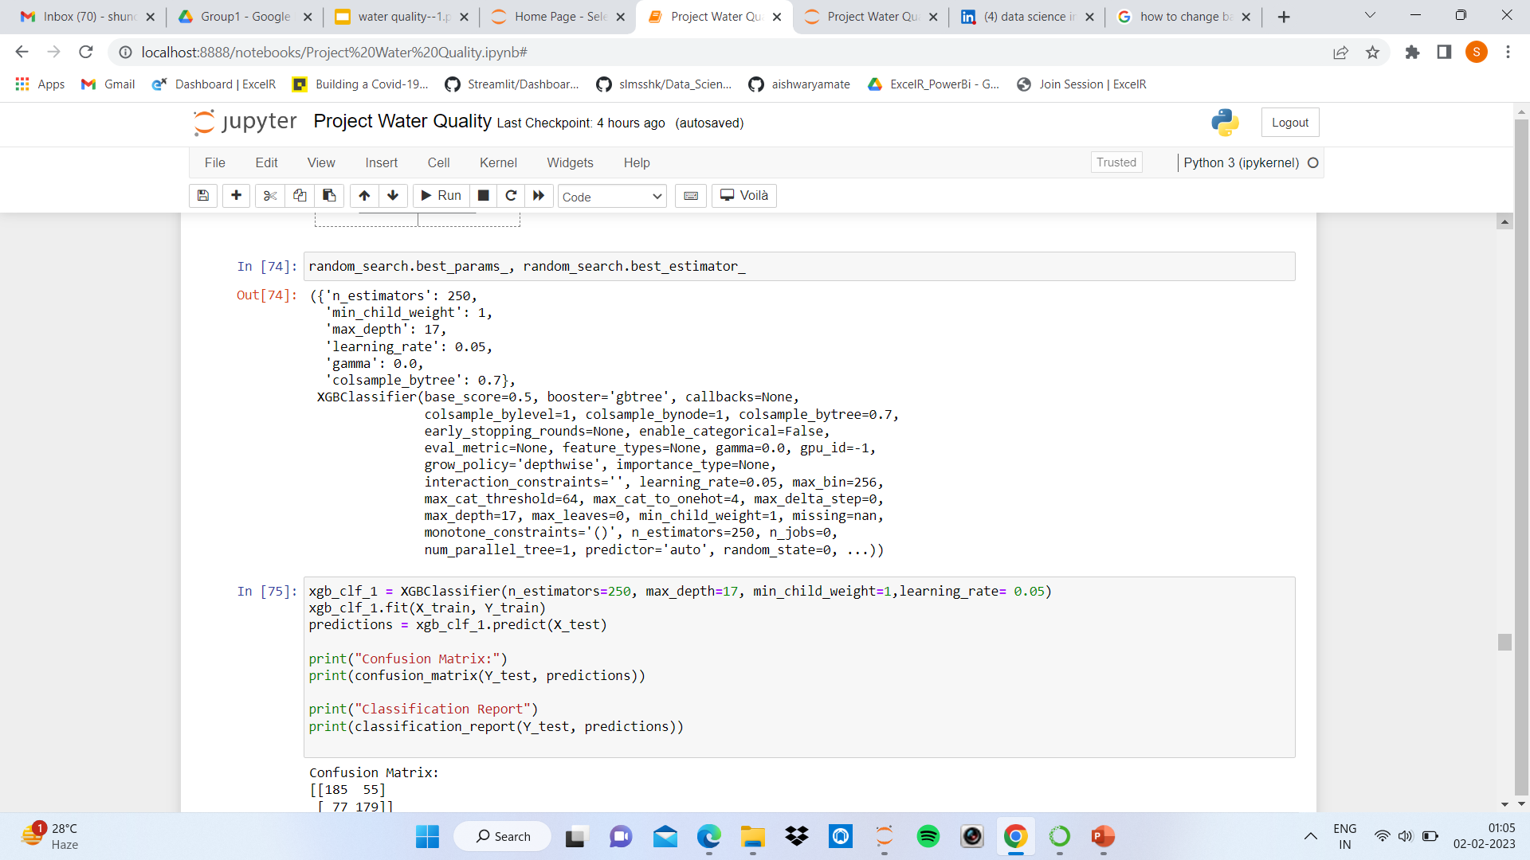
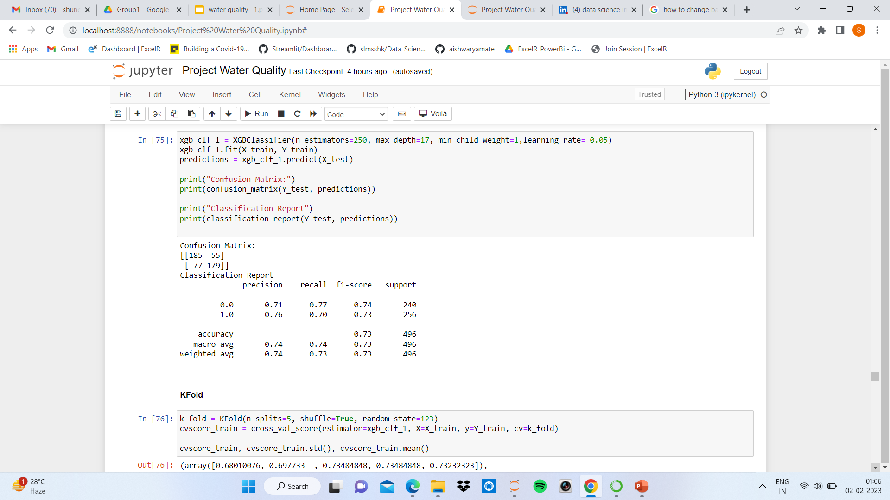

Slide 42
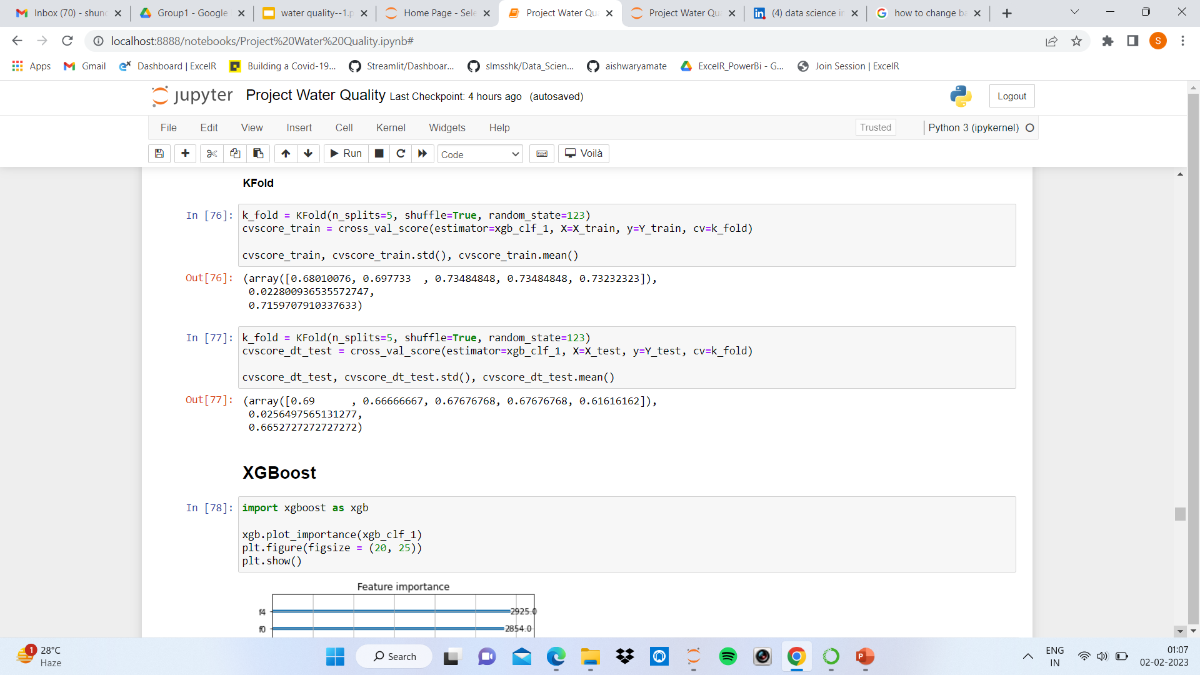

Slide 43
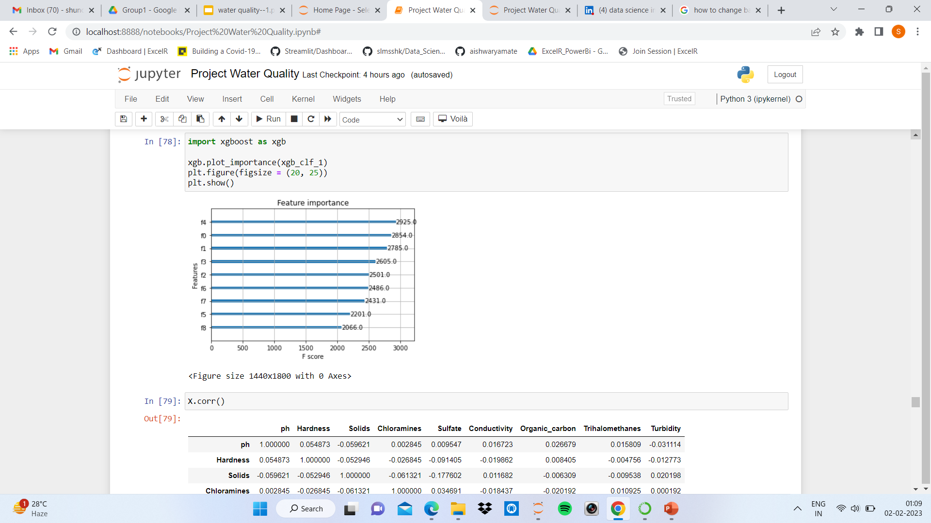
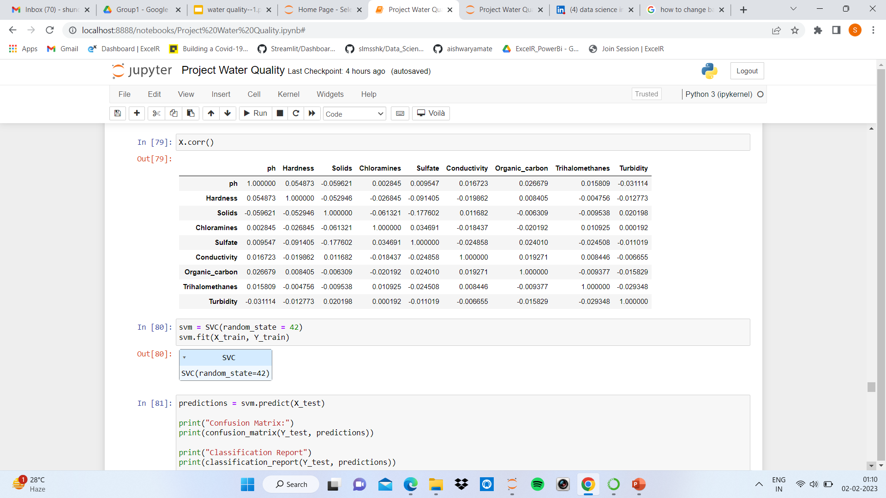
XGBoost

Slide 44
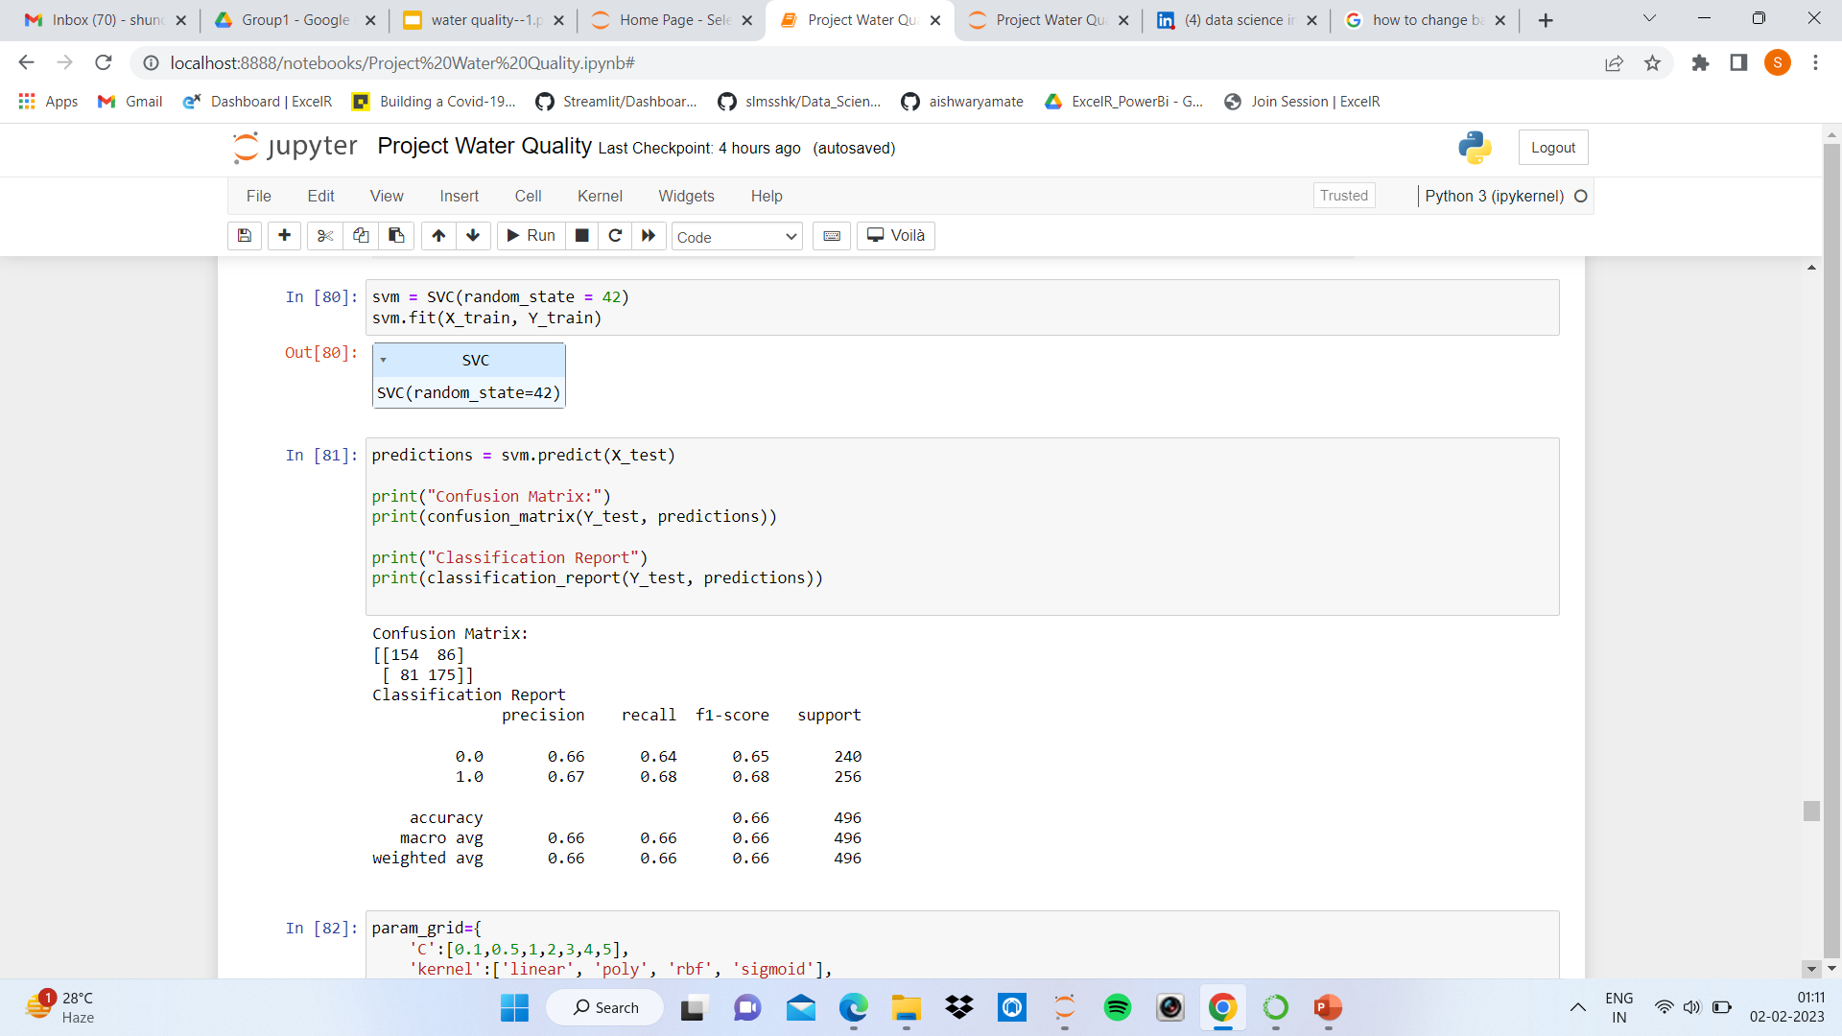
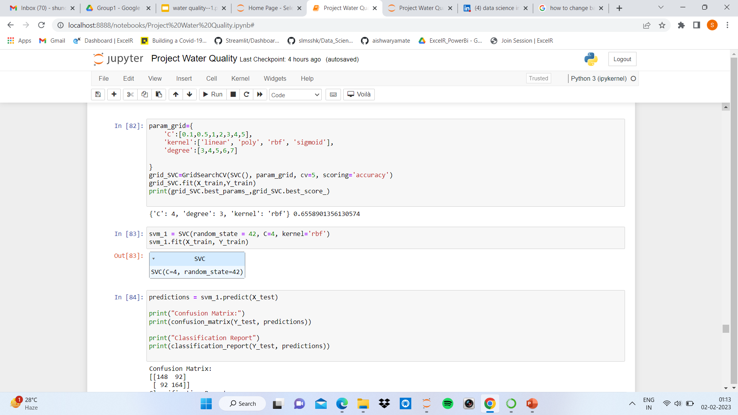
SVC

Slide 45
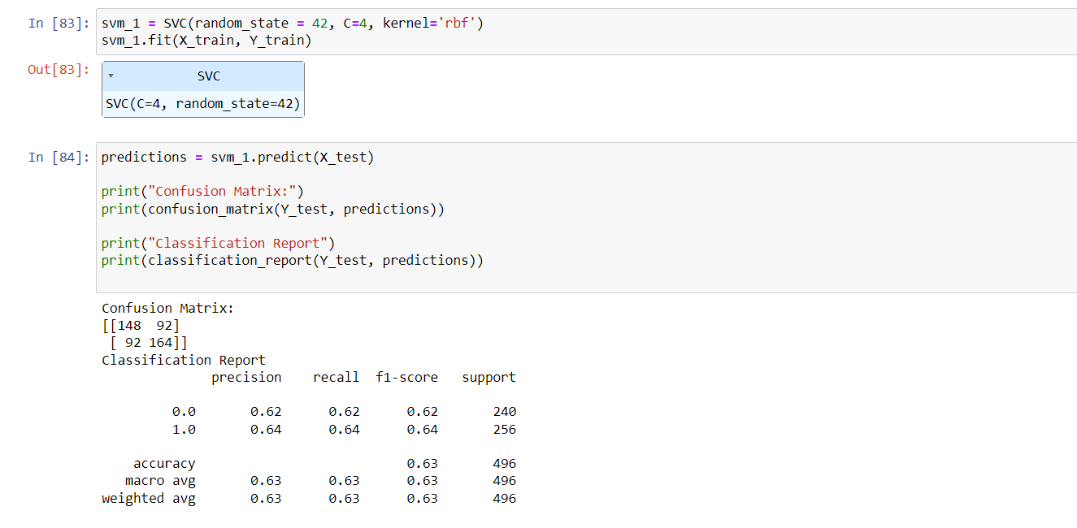

Slide 46
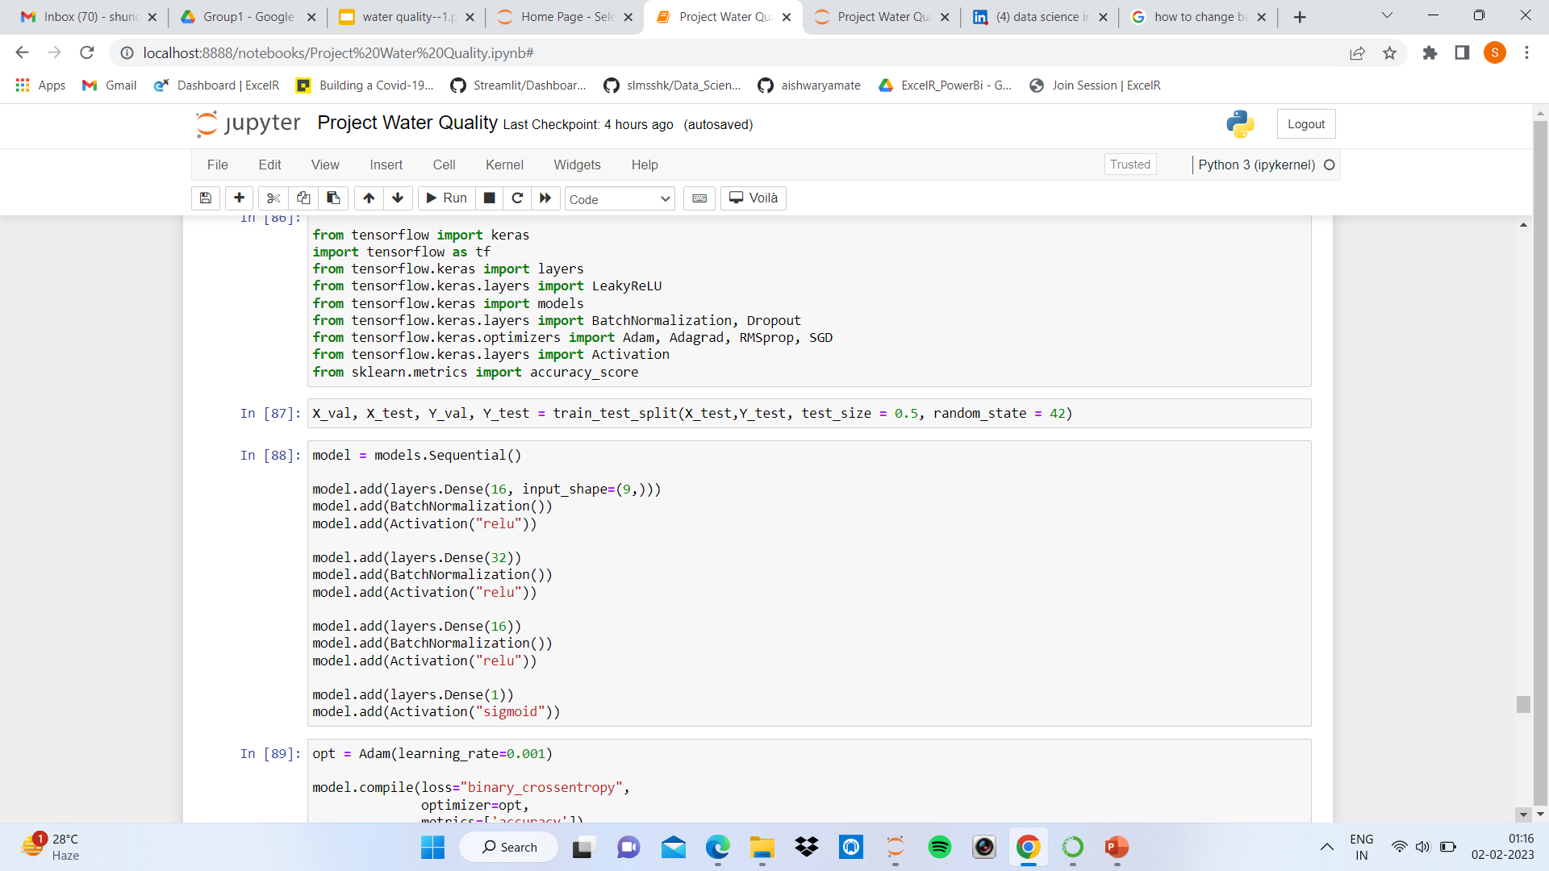
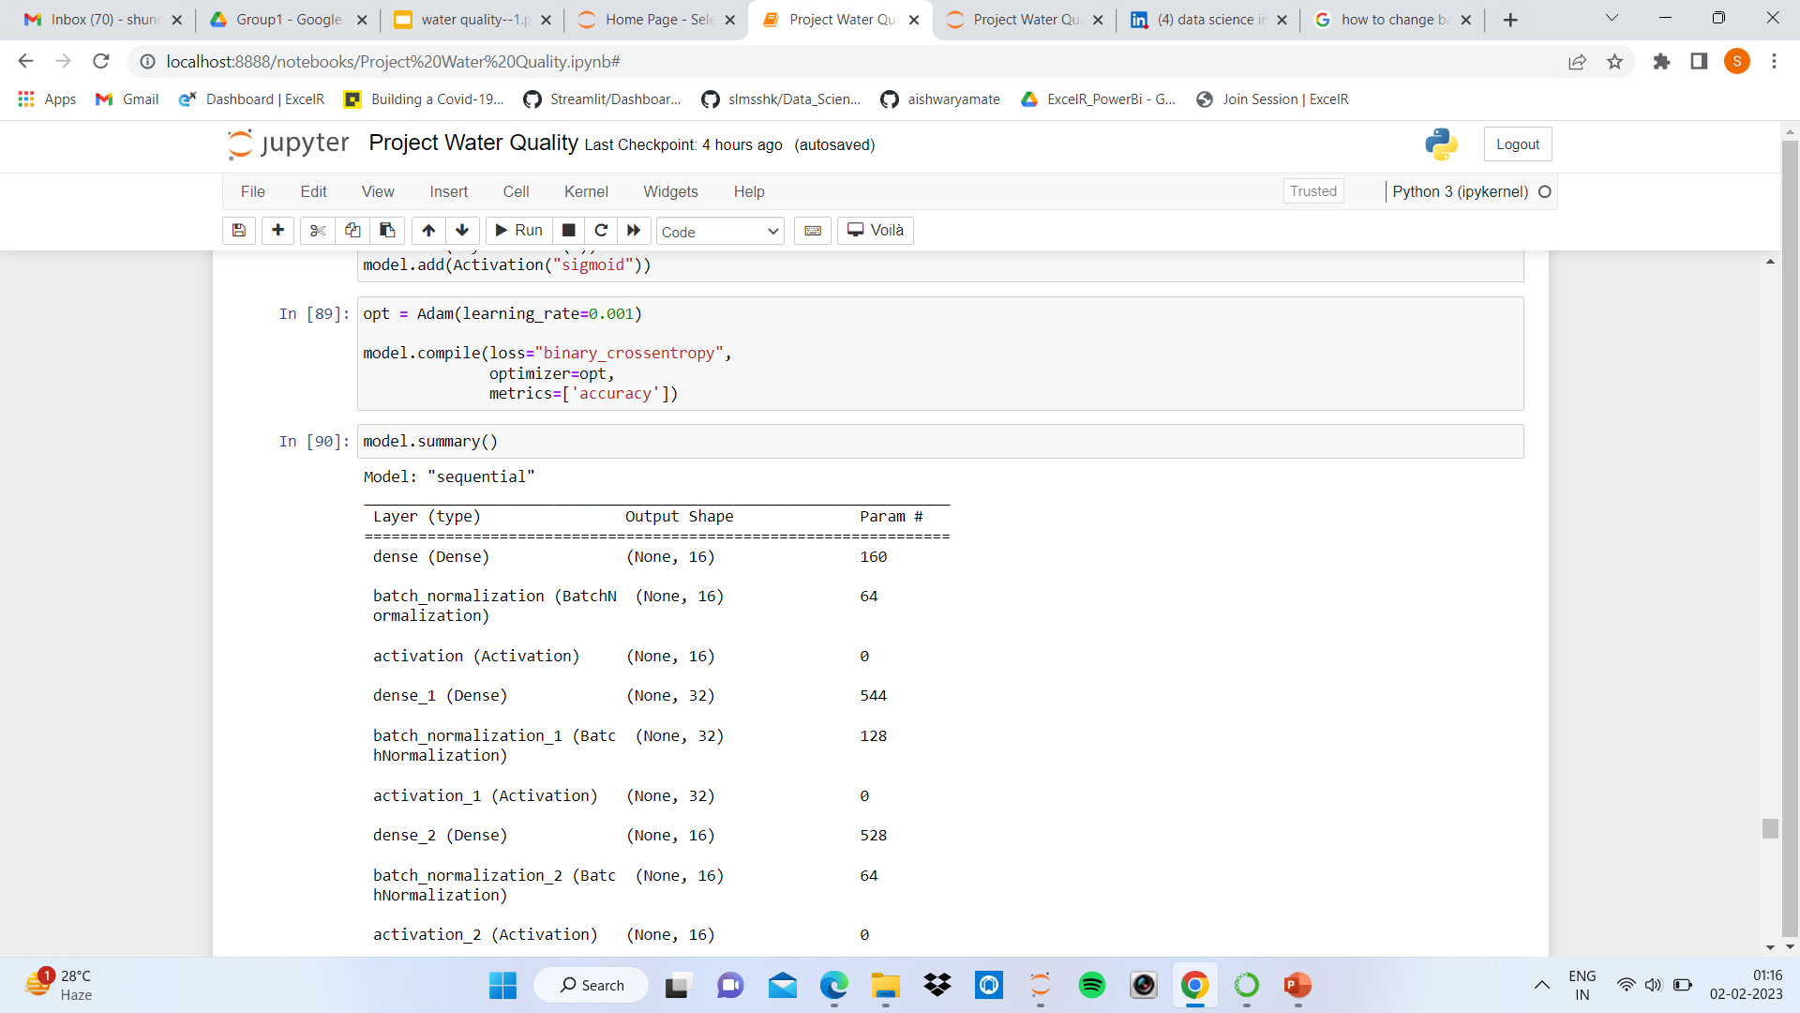
Tensor Flow

Slide 47

Model Summary

Slide 48



Slide 49



Slide 50

Final Model

Slide 51



Slide 52


Features Importance

Slide 53


Slide 54

Pickle

Slide 55

Deployment
Predicted Result – Water is Portable

Slide 56

Predicted Result – Water is Not Portable

Slide 57
Challenges Faced
Handling the Missing Value.
Challenge to Build Model for Best Accuracy.
Deployment (Streamlit) – to run Streamlit

Slide 58
Thank You

